Slide 1
What is Culture?

Slide 2
Culture
The culture of a society is the product of the religion, beliefs, customs, traditions, and government of that society.
Notes:
2
K, 1, 6, 7, WH, USH, WG

Slide 3
Culture
Culture is how people think, act, celebrate, and make rules, and that it is what makes a group of people special.
Notes:
3

Slide 4
What are characteristics of culture?
Culture is learned and is not based on instinct.
It is handed down from generation to generation. This is reflected in basic needs. For example what is edible, when the right time and place is to sleep.
Culture is adaptive. We adapt to our environments with tools, boats, houses, growing different foods in different climates, etc.
Culture is symbolic. How people see the world is based on symbols and the meaning behind those symbols.
Culture is shared by a group of people in a society and formed through interactions.
Culture also shapes the way we think about the world, gender roles, stereotypes and how we view other cultures.

Slide 5
Characteristics of Culture
Symbols
Language
Values
Norms
Mores
Folkways
Laws
Taboos
Technology
Artifacts

Slide 6
LANGUAGE
- A system of patterned sounds, often with corresponding written symbols, that the members of a society use to communicate their thoughts and feelings to one another
Examples-Swahili, English, Spanish, French

Slide 7
Languages of Europe
Unit 2

Slide 8
Activator

Slide 9
Activation Activity
Make a list of the “Languages of the world”. Try to write all the different languages you know. See how many you can get. Now write the country you think the language came from.
Example: English = United States

Slide 10
Standard and Element
SS6G11 The student will describe the cultural characteristics of Europe.
a. Explain the diversity of European languages as seen in a comparison of German, English, Russian, French, and Italian.

Slide 11
Teaching

Slide 12
European Languages
Europe is a continent with several different countries.
With all those different countries come several different cultures.
One aspect of culture is language
Many countries in Europe speak different languages
Many of these languages can be divided up into three categories because they have similar aspects
Those three categories are:
Germanic
Romance
Slavic

Slide 13
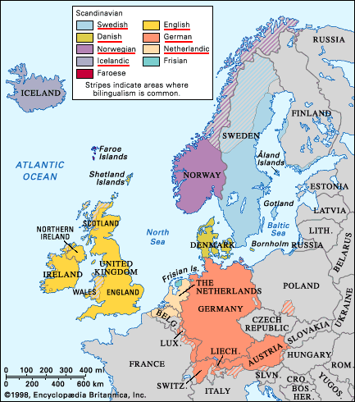
Germanic Languages
Germanic Languages have the most native Speakers
They are usually found in the northwest and central Europe
Some examples of this type of language is English and German
Most Europeans learn English as a second language

Slide 14
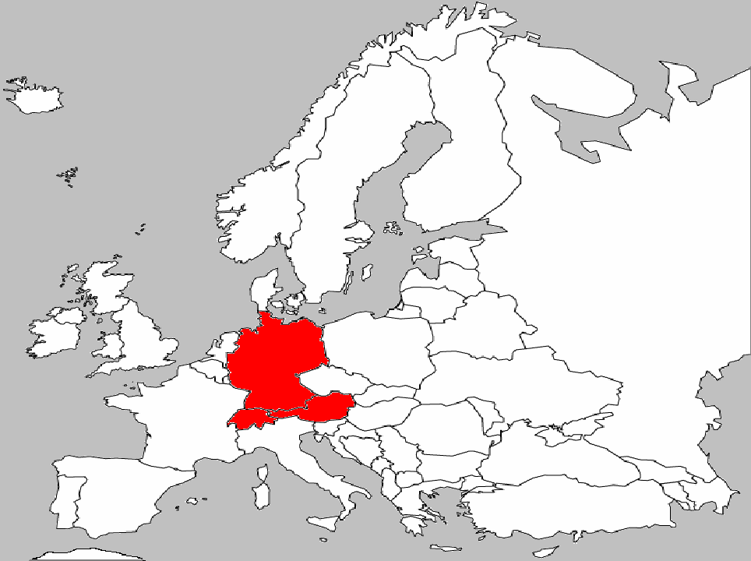
German Language
The German Language is the official Language of both Germany and Austria
German is also spoken in Switzerland, eastern France, Luxembourg, Italy, and some parts of Eastern Europe including Romania and Russia.
There are two major dialects
“Low German”
Spoken in the north
“High German”
Spoken in the south

Slide 15
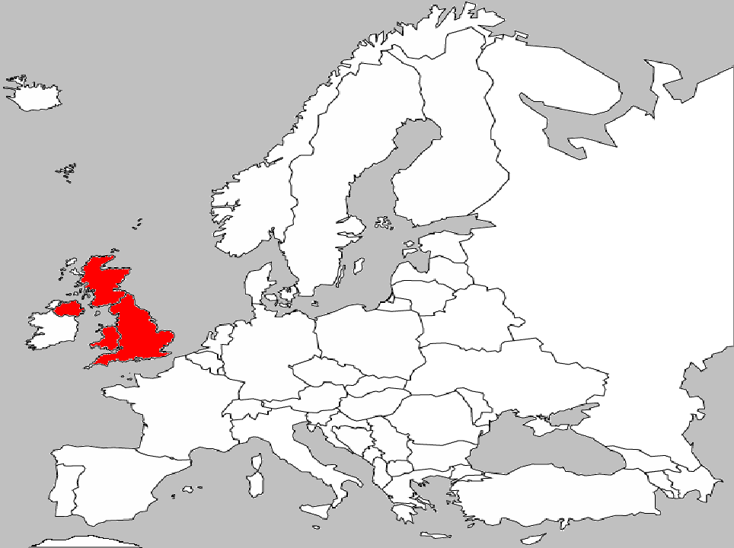
English Language
English is spoken in the United Kingdom
The United Kingdom is a combination of Northern Ireland, England, Scotland, and Wales
The English language originated in Germany
English is based on a mixture of several different languages

Slide 16
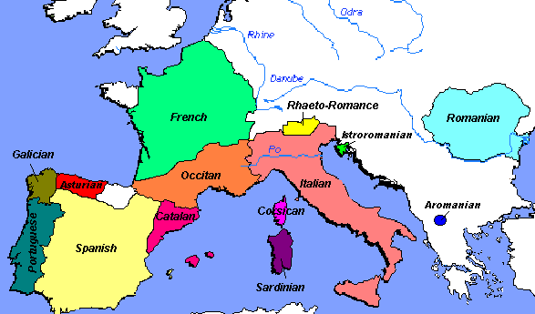
Romance Languages
Romance languages are found in South West Europe
The languages comes from the ancient language of Latin
Latin is the language of the Ancient Roman empire
The same alphabet is used for Germanic and Romance languages
Examples of this type of language are Italian, French, Spanish.

Slide 17
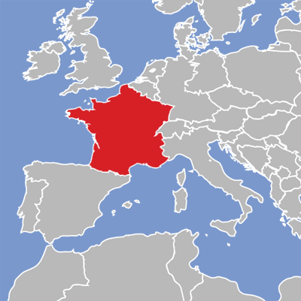
French Language
French is spoken in France
Traces their roots back to Latin
“Romanica Ioqui” is Latin. It means “to speak in Roman Fashion”
Known as a “Romance Language”

Slide 18
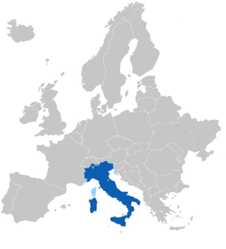
Italian Language
Italian is spoken in Italy
Traces their roots back to Latin
“Romanica Ioqui” is Latin. It means “to speak in Roman Fashion”
Known as a “Romance Language”

Slide 19
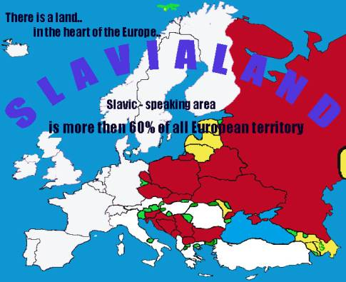
Slavic Language
Slavic Languages are found in central and eastern Europe
These language are written in a Cyrillic alphabet
One example is Russian

Slide 20
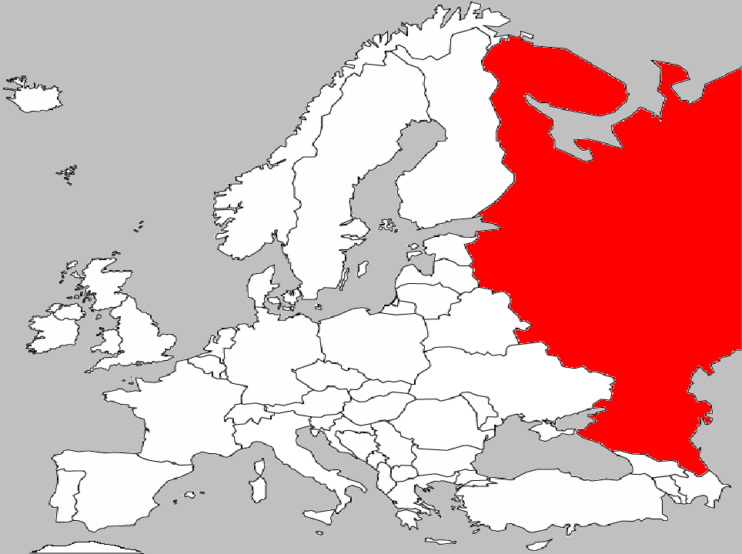
Russian Language
Russian
Russian is spoken in Russia
Originates from many Slavic Languages
Many different dialects spoken

Slide 21
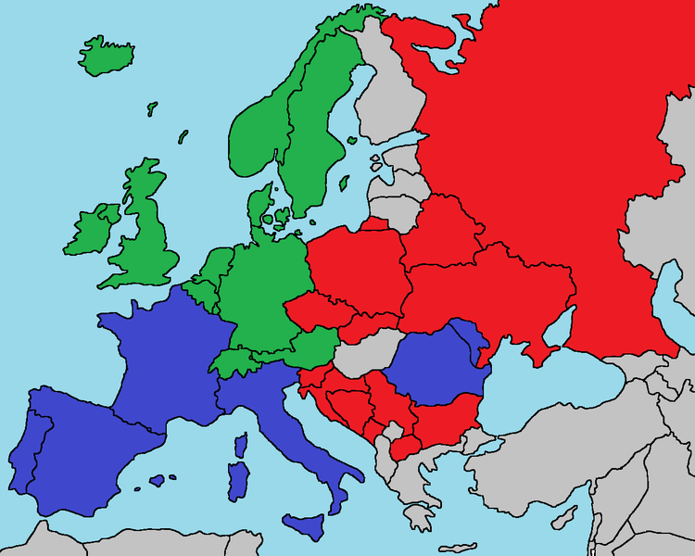
This map shows where the different categories of languages are spoken. In Blue is Romance, Green is Germanic, and Red is Slavic.

Slide 22
Major Languages of the World
L

Slide 23
Languages of Europe Power Point Guide Review

Slide 24
Power Point Guide Review
Teaching
Europe is a continent with several different Countries.
With all those different countries come several different Cultures.
One aspect of culture is Languages.
Many countries in Europe speak different Languages.
Many of these languages can be divided up into three categories because they have similar Aspects.
Those three categories are: Germanic; Romance; Slavic
Germanic Languages
Germanic Languages have the most Native Speakers.
They are usually found in the northwest and Central Europe.
Some examples of this type of language is English and German.

Slide 25
Power Point Guide Review-Continue
Most Europeans learn English as a Second language.
German Language
The German Language is the Official Language of both Germany and Austria.
German is also spoken in Switzerland, eastern France, Luxembourg, Italy, and some parts of Eastern Europe including Romania and Russia.
There are two major Dialects.
“_Low German”
Spoken in the north
“High German”
Spoken in the south

Slide 26
Power Point Guide Review-Continue
English Language
English is Spoken in the United Kingdom.
The United Kingdom is a Combination of Northern Ireland, England, Scotland, and Wales
The English language originated in Germany.
English is based on a mixture of several different Languages.
Romance Languages
Romance languages are found in South West Europe.
The languages comes from the ancient language of Latin.
Latin is the language of the Ancient Rome empire.
The same Alphabet is used for Germanic and Romance languages
Examples of this type of language are Italian, French, and Spanish.

Slide 27
Power Point Guide Review-Continue
French Language
French is spoken in France.
Traces their roots back to Latin.
“Romanica Ioqui” is Latin. It means “to speak in Roman Fashion ”
Known as a “Romance Language”
Italian Language
Italian is spoken in Italy.
Traces their roots back to Latin.
“Romanica Ioqui” is Latin. It means “to speak in Roman Fashion ”
Known as a “Romance Language”

Slide 28
Power Point Guide Review-Continue
Slavic Language
Slavic Languages are found in Central and eastern Europe.
These language are written in a Cyrillic alphabet.
One example is Russian.
Russian Language
Russian is spoken in Russia.
Originates from many Slavic Languages.
Many different Dialects are spoken.

Slide 29
Work Session

Slide 30
Tree Map
Create a tree map that shows the different categories of languages and provides adequate information about that language.
Languages of Europe
Germanic Languages
Romance Languages
Slavic Language

Slide 31
Weak Work

Slide 32
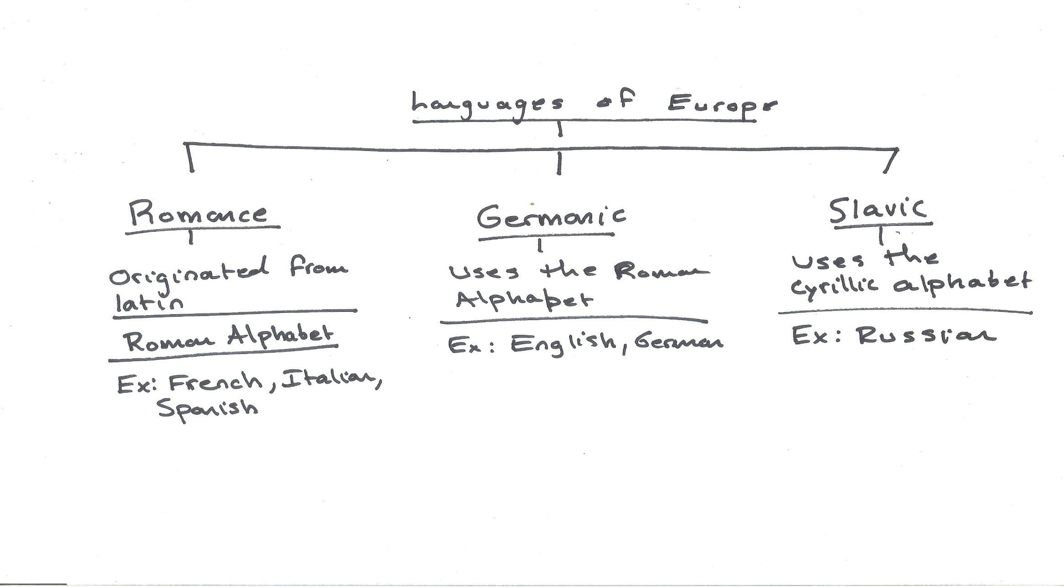
Strong Work

Slide 33
Summarizer

Slide 34
Answer the following questions in a short essay
What are the different types of languages found in Europe? What are some examples of those languages? What makes those languages unique?

Slide 35
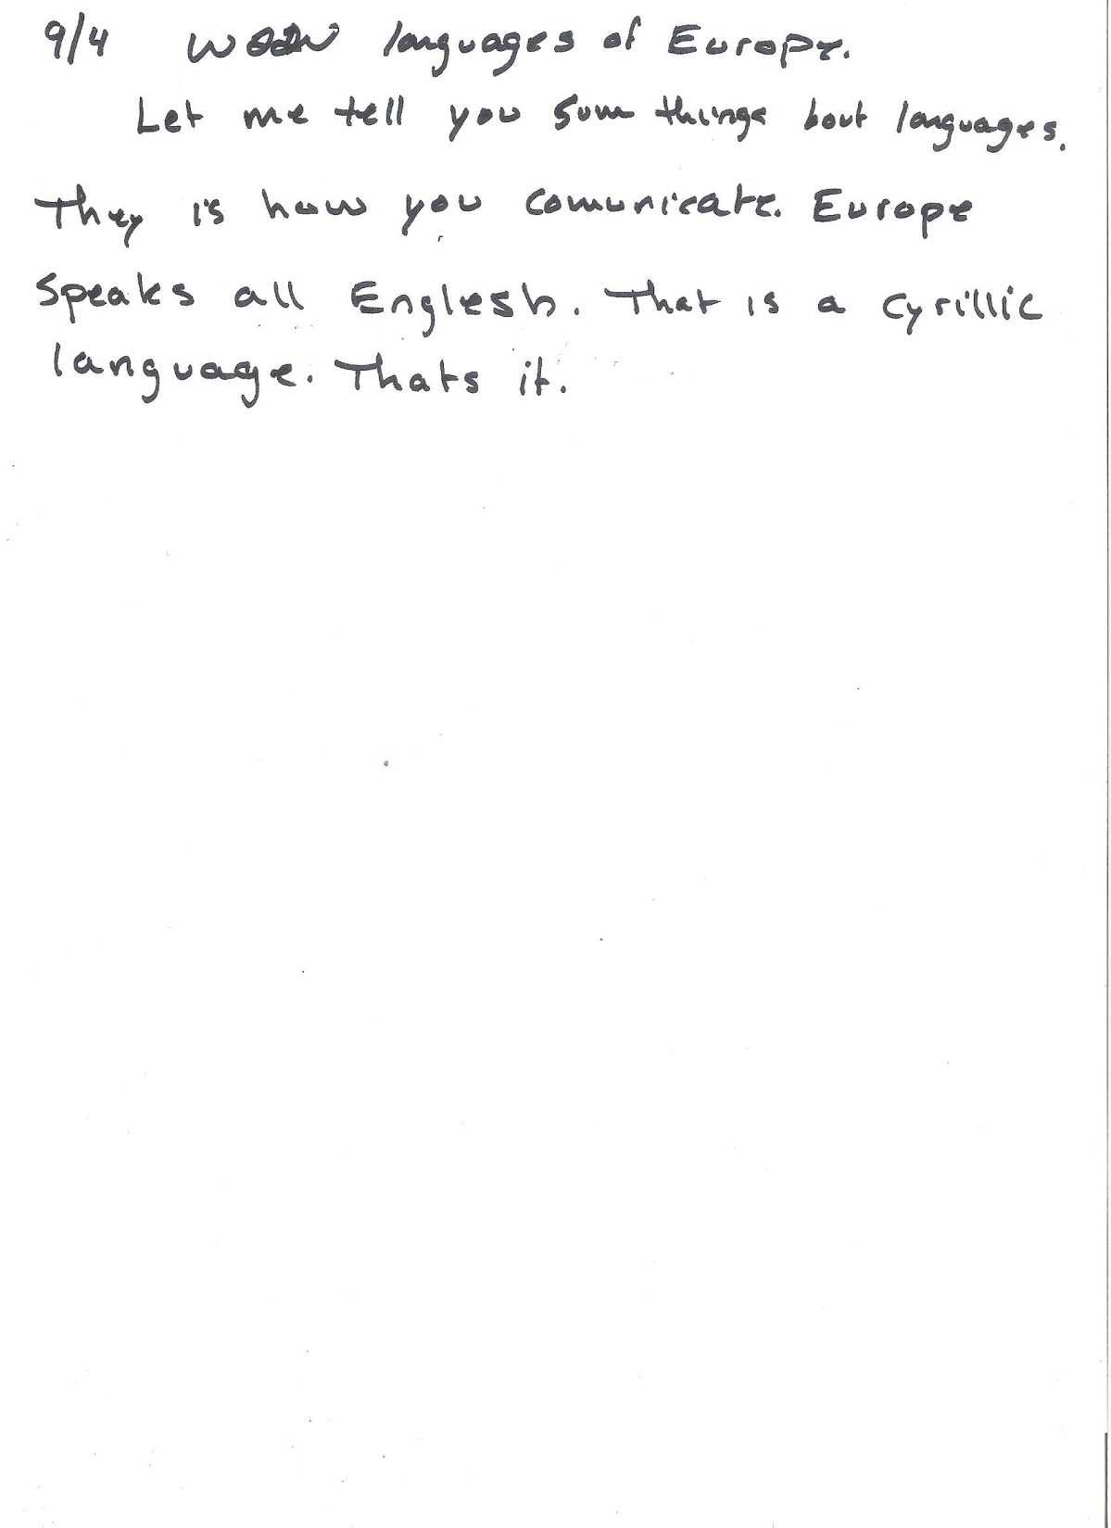
Weak Work

Slide 36
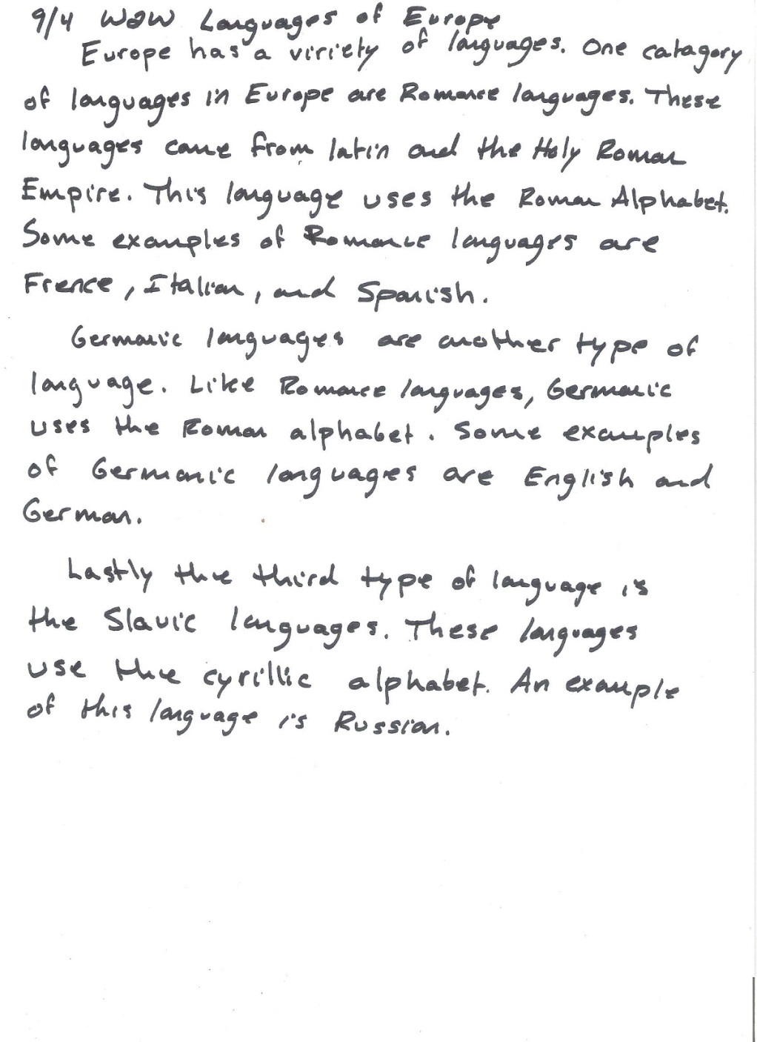
Strong Work

Slide 37
PowerPoint Quiz

Slide 38
Power Point Quiz
1.What are some reasons Great Britain has such a great economy?
Island, not a part of mainland Europe
Developed and industrialized nation
Climate favorable for agriculture
All of the Above
2.The two major dialects of German are…
“High German” and “Top German”
“Low German” and “High German”
“West German” and “East German”
“North German” and “South German”
3.How are the French and Italian Language alike?
They both trace their language to Latin
They are both spoken in Italy
They are both from Russia
They have nothing in common
4.What languages are Known as the “Romance Languages?”
English and German
Italian and French
German and French
English and Russian

Slide 39
Questions
Why are there so many different languages in Europe?
There have been many changes to Europe’s political boundaries over the years.
What are the dominant languages in Europe?
German, English, Russian, French, and Italian

