Slide 1
Using Slope Intercept Form to Graph
Teacher Twins©2014

Slide 2
Warm Up
Write the slope and the y intercept.
y = 3x – 6 2. y = $\frac{5}{3}x −4$
$3. y= \frac{−3}{7}$x + 12 4. y = 5x – 9
5. y = $\frac{−5}{6}$x – 7 6. y = $\frac{4}{5}$x - 5
m = 3, b = -6
m = $\frac{5}{3},$b = -4
m = -3/7, b = 12
m = 5, b = -9
m = -5/6, b = -7
m = 4/5, b = -5

Slide 3
Using Slope Intercept Form to Graph

Slide 4
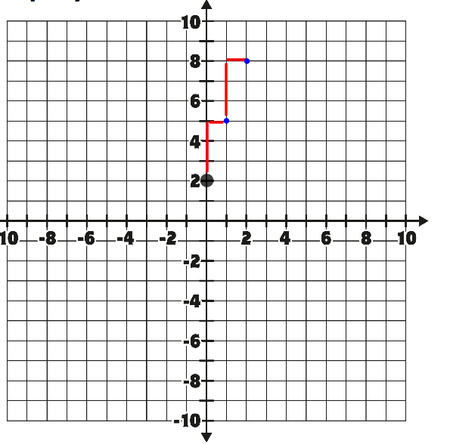
From the y intercept use the slope. 3 is the slope so go up 3 over 1 to the right.
Graph y=3x+2
Start at the y intercept.

Slide 5
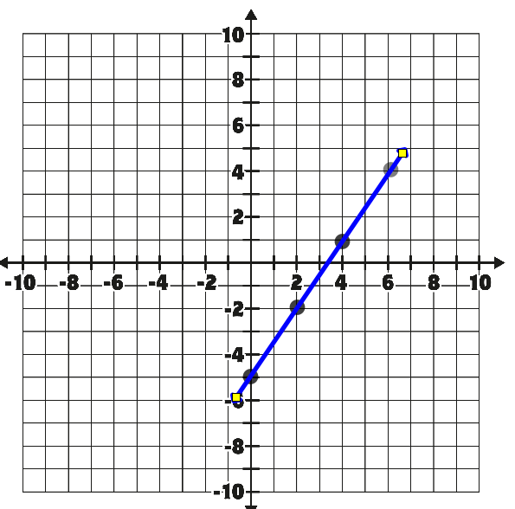
Graph y = $\frac{3}{2}$x - 5
Use slope – up 3 over 2 right.
Graph y intercept.

Slide 6
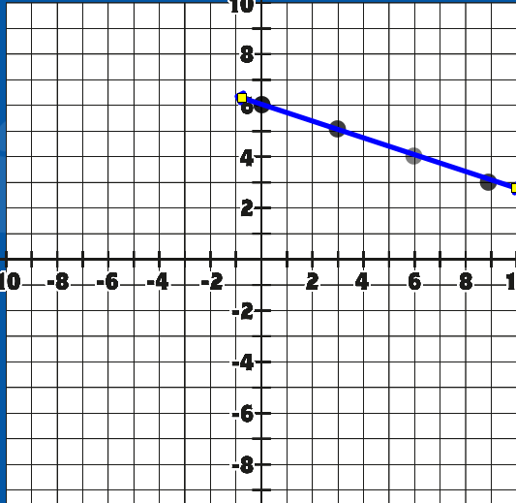
Graph y = $\frac{−1}{3}$x + 6

Slide 7
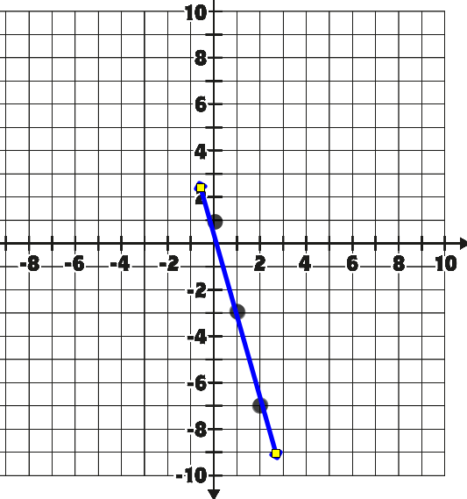
Graph y = -4x + 1

Slide 8
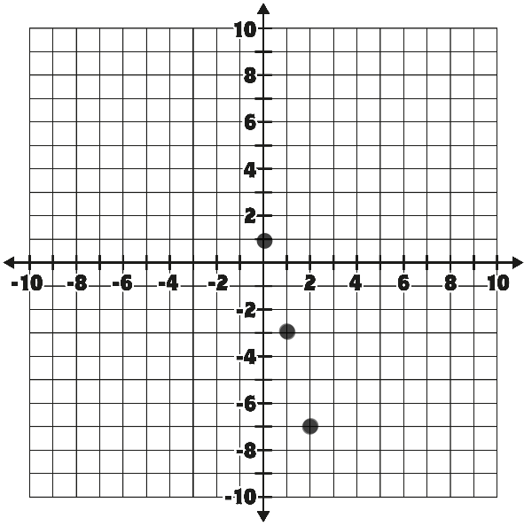
Closure
How can I graph ordered pairs to the left of the y intercept?
Do the opposite. Instead of going down 4 right 1 go up 4 left 1.

