Slide 1
Distribution
of Power
Unitary, Confederation, & Federal

Slide 2
Governments
So why do we need governments anyways?
Turn and discuss this question with your elbow partner.

Slide 3
Governments
All countries require governments to function.
Governments provide laws, structure, public services, and national defense.
There are different types of governments:
democracies
republics
monarchies
dictatorships

Slide 4
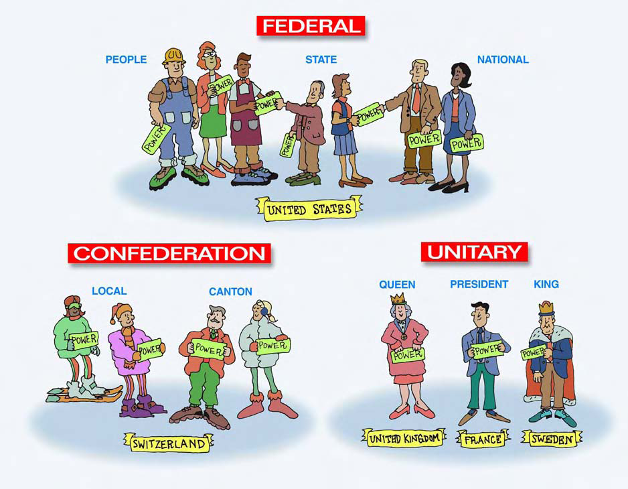
How is Power Shared?

Slide 5
Federal
System

Slide 6
Federal System
In a federal system, power is shared by a powerful central government and the state or local governments.
States or provinces are given considerable self-rule, usually through their own legislatures.

Slide 7
Federal System
In a federal form of government, power is divided between a central government & small divisions, such as states.
A document (such as a constitution) may describe the rights, responsibilities, and duties of the central government & the states.
Central government can be powerful, but does not have the ability to dissolve states or choose state leaders.

Slide 8
Federal Government- power of the Central government is separate from State Government
Central
Government
State/Local
Government
The Federal
Constitution
Laws Rule Both Central and State

Slide 9
Federal Countries
Many countries use this form of distributing government power.
Western hemisphere: Brazil, Canada, Mexico, US, Venezuela, etc.
Europe: Russia, Germany, etc.
A federal system does not mean that there is more or less personal freedom for the people. It explains how power is distributed.

Slide 10
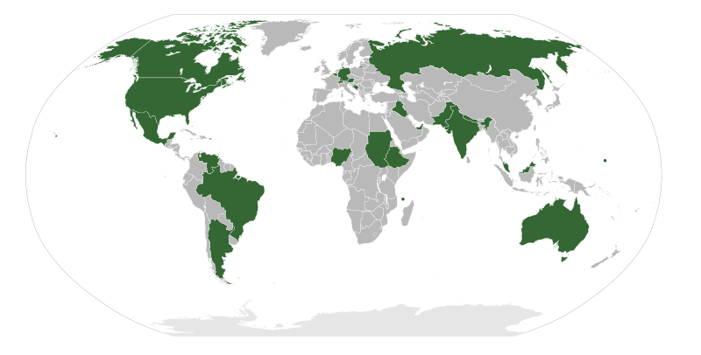
Federal Governments

Slide 11
Let’s Review
How does a federal system of government divide power?
2. What defines the rights, responsibilities, & duties of the central & state governments?

Slide 12
Let’s Review
How does a federal system of government divide power?
Between the central government and smaller units such as states
2. What defines the rights, responsibilities, & duties of the central & state governments?
A constitution

Slide 13
Unitary
System

Slide 14
Unitary System
In a unitary system, the power is held by one central authority.
All power is given to one branch of government.

Slide 15
Unitary System
In a unitary government, the central government has most of the authority and decision-making power.
Local government offices are part of the central government.
The central government maintains all power over the local governments.
Unitary governments may not be less democratic (when ordinary citizens get to vote) than other forms--it all depends on who is in charge!

Slide 16
Unitary Government
Central
Government
has all the power
The Local
Governments
are not separate,
but are smaller parts
of the Central government
Local Government
Local
Government
Local Government
Same as Central
Same as Central
Same as Central

Slide 17
Unitary Countries
Many countries in the world are run this way.
Western hemisphere: Cuba & Bolivia
Europe: United Kingdom, Sweden, Spain, & France

Slide 18
Unitary Governments

Slide 19
Let’s Review
How is power distributed in a unitary government?
True or False: In a unitary government, the national government could remove the governor of a state and pick a new one.
France, UK, Bolivia, and Cuba--what do these countries have in common?

Slide 20
Let’s Review
A central government assigns power and duties to smaller units of government within the country.
True or False: In a unitary government, the national government could remove the governor of a state and pick a new one.
True
All have unitary government systems

Slide 21
Confederation

Slide 22
Confederation
A confederation is a system in which power is shared by an alliance of independent states (countries).
They voluntarily work together for some common purpose and agree to certain limits on their freedom of action.
Examples: European Union, OPEC

Slide 23
Confederation
Some countries agree that they would be better able to solve problems or provide help if they worked together.
They might sign a treaty or a constitution under which the countries agree to defend each other, trade with each other, use a common currency, etc.
Membership is usually voluntary & a country can decide to leave at any time.

Slide 24
Confederation
Not commonly found among governments in the 21st century because there are several problems with them:
Often have little power because a high percentage of members must agree to decisions made,
Individual countries can veto decisions, &
Changes in the constitution requires all members to agree.
Confederations generally have a weak central government.

Slide 25
Let’s Review
What is one problem with a confederation government?
In a confederation, government power lies with the ______________________.

Slide 26
Let’s Review
What is one problem with a confederation government?
The central government can create laws but might not be able to enforce them
In a confederation, government power lies with the ______________________.
Governments of the member countries/states

Slide 27
Show What You Know
Let’s get in groups of three. Number yourselves one, two, and three.
Ones explain to the twos and threes how a unitary government system distributes power.
Twos explain to the ones and threes how a confederation government system distributes power.
Threes explain to the ones and twos how a federal government system distributes power.

