Slide 1
Ratios
TeacherTwins©2014

Slide 2
2
Warm Up
How are these two groups alike? Different?
Group 1
Group 2

Slide 3
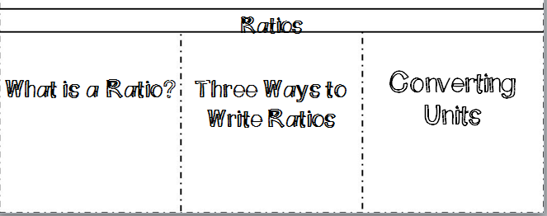
Ratio Flippable

Slide 4
Ratio- A comparison of two or more things.
You should write ratios in simplest form.
Examples: 2 boys for every 3 girls
3 dollars for 5 pencils

Slide 5
Below are three ways to write a ratio.
3 to 4
3:4
¾
Write each ratio in two different ways.
Example 1: 9 dogs to 12 cats
Example 2: 27 pencils to 15 pens
9:12 and $\frac{9}{12}$ simplified 3:4 3/4
27 to 15 and $\frac{27}{15}$
Simp. 9 to 5 9/5
Do not write ratios as mixed numbers they should be improper fractions.

Slide 6
Converting Units
When writing ratios that are comparing the same type of measurement (length, weight, time, etc.) you should use the same unit.
Example 3: Write the ratio 3 feet to 5 inches as a fraction in simplest form.
$$\frac{3 feet}{5 inches}=\frac{ inches}{ inches}$$
36
5

Slide 7
Practice
Write a ratio for each situation in 3 ways.
1). About 1 out of 8 people run at least 4 times a week.
2). About 24 out of 25 students prefer chocolate ice cream to vanilla ice cream.
3). A basketball team won 8 out of 15 games. Find the following:
Wins to total games
Wins to losses
4). Write the following ratios in the same unit.
a). 4 minutes to a half of an hour
b). 2 yards to 4 feet
1/8, 1 to 8, 1:8
24/25, 24 to 25, 24: 25
8/15, 8 to 15, 8:15
8/7, 8 to 7, 8:7
$$\frac{4}{30} simplifies to \frac{2 min}{15 min}$$
$$\frac{6 }{4}simplifies to \frac{3 ft}{2 ft}$$

Slide 8
Closure
When would you use a ratio in everyday life?

