Slide 1
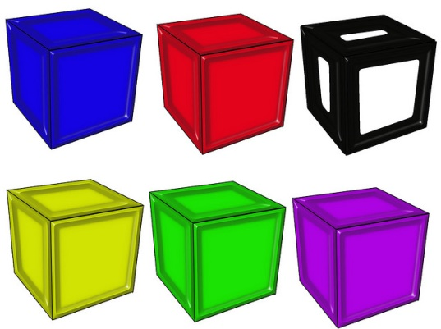
Unit Rates

Slide 2
Warm Up
Complete the Frayer Model
Define Ratio in your own words
Draw a picture to show what the word ratio means
Ratio
Give an example of a ratio
Give a non-example of a ratio

Slide 3
A rate is a ratio that compares two quantities measured in different units.
Example: 120 miles in 2 hours
A unit rate is a rate that is compared to one. It has one as its denominator.
Example: 60 miles in 1 hour
60 miles/hour

Slide 4
Example 1: There are 15 hot dogs for 5 campers. How many hot dogs will each camper get?
We divide the 15 hot dogs by the 5 campers to get the unit rate.
Camper 1
Camper 2
Each camper will get 3 hot dogs.
The unit rate is
3 hot dogs per one camper.
Camper 3
Camper 4
Camper 5

Slide 5
Example 2: John has 2 candy bars for 3 people. How much will each person receive?
You can find the unit rate by using a diagram.
1
1
2
2
3
3
Each person would receive 2/3 of a candy bar.
The unit rate is 2/3:1 or 2/3 candy bar per one person.
You can also find it by dividing 2 candy bars by 3 people which is 2/3 or about 0.7.

Slide 6
Example 3: La can run 10 miles in 2 hours.
Write 2 unit rates. Find the miles per hour and the hours per mile.
1
2
3
4
5
1 hour
1 hour
La can run 5 miles in one hour.
You can divide 10 miles by the 2 hours to help you get the unit rate.
You can also you use a tape diagram.

Slide 7
Example 3 Contined: La can run 10 miles is 2 hours.
Write 2 unit rates. Find the miles per hour and the hours per mile.
1 mile
1 hour
In 1 hour La can run 5 miles.
It will take La 1/5 of an hour to run one mile or 0.2 hour to run one mile.

Slide 8
Practice
1). Stephen earned $75 for 10 hours of work. How much money did he make in one hour?
2). Kim walked 6 miles in one and a half hour. How many minutes did it take her to walk one mile?
3). Ike bought 6 pencils for $1.20. What is the price per pencil?
4). To make 8 cakes you use 12 cups of flour.
How much flour is needed for one cake?
$7.50 for one hour
15 minutes to walk one mile
$0.20 for one pencil
1.5 cups of flour for one cake

Slide 9
Closure
How are ratios and unit rates alike? Different?

