Slide 1
Dividing Fractions and Mixed Numbers

Slide 2

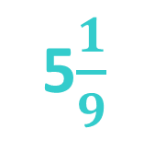


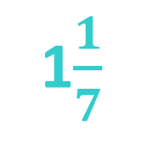
Warm Up
Multiply
2$\frac{2}{5}$ x $\frac{10}{21}$ 2. $\frac{3}{4}$ x $\frac{7}{9}$
3. $\frac{12}{35}$ x $\frac{7}{10}$ 4. 3$\frac{5}{6}$ x 1$\frac{1}{3}$
$$\frac{7}{12}$$
1$\frac{1}{7}$
5$\frac{1}{9}$
$$\frac{6}{25}$$

Slide 3
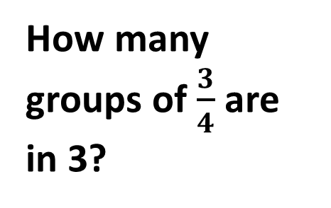
How many groups of $\frac{3}{4}$ are in 3?
Example 1: 3 ÷ $\frac{3}{4}$
There are 3 groups of three fourths (in blue). There are 3 more fourths leftover (in white).
There are a total of 4 groups of three fourths.

Slide 4
Two numbers are reciprocals if their product equals one.
The reciprocal of $\frac{2}{3}$ is $\frac{3}{2}$ .

Slide 5
3 ÷ $\frac{3}{4}$
To divide fractions you multiply by the reciprocal.
3 x $\frac{4}{3}$ = $\frac{3}{1 }$ x $\frac{4}{3}$
= 4

Slide 6
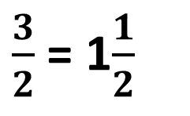
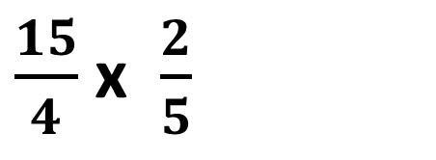


Example 2: 3$\frac{3}{4} ÷$ 2$\frac{1}{2}$
3$\frac{3}{4}$ = $\frac{15}{4}$
$\frac{15}{4}$ ÷ $\frac{5}{2}$ = $\frac{15}{4}$ x $\frac{2}{5}$
3
$\frac{15}{4}$ x $\frac{2}{5}$
2$\frac{1}{2}$= $\frac{5}{2}$
1
$\frac{3}{2}$ = 1$\frac{1}{2}$
1
2

Slide 7
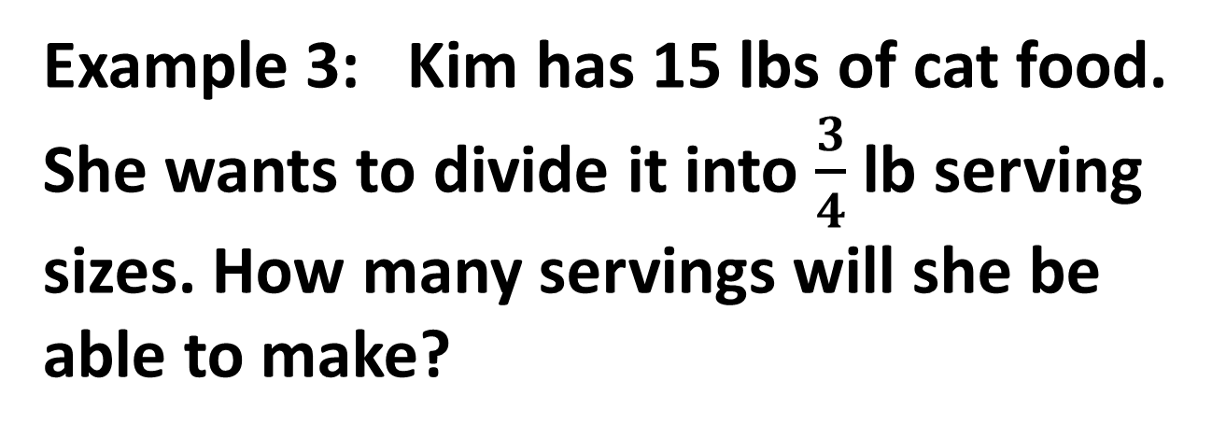
Example 3: Kim has 15 lbs of cat food. She wants to divide it into $\frac{3}{4}$ lb serving sizes. How many servings will she be able to make?
15 ÷ $\frac{3}{4}$ = $\frac{15}{1}$ x $\frac{4}{ 3}$ = 20

Slide 8

Practice
Divide
$\frac{12}{25}$ $÷$ $\frac{3}{5}$
$\frac{3}{7}$ ÷ $\frac{7}{8}$
1$\frac{1}{2}$ ÷ 2$\frac{1}{3}$
12 $÷ \frac{5}{6}$
$$\frac{4}{5}$$
$$\frac{24}{49}$$
$$\frac{9}{14}$$
14$\frac{2}{5}$

Slide 9
Closure
Write a word problem that can be solved by dividing 10 by $\frac{1}{2}$.

