Slide 1
The
Cuban
Revolution

Slide 2
Standards
SS6H3 The student will analyze important 20th century issues in Latin America and the Caribbean.
a. Explain the impact of the Cuban Revolution.

Slide 3
Teachers
Print off the following page for each student. They should complete the graphic organizer while discussing the presentation.

Slide 4
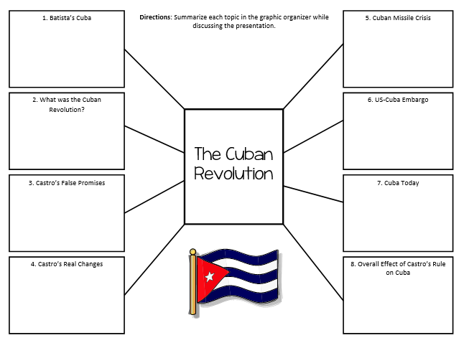

Slide 5
The
Cuban
Revolution

Slide 6
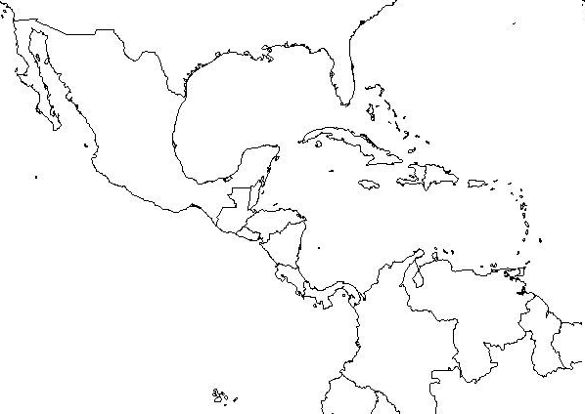
Where is Cuba?

Slide 7
Cuba in the 1900s
Cuba gained its independence from Spain in 1898.
In the 1900s, Cuba’s wealth was controlled by American companies.
The main businesses in Cuba were sugar and mining companies.
The leader of Cuba was Fulgencio Batista.

Slide 8
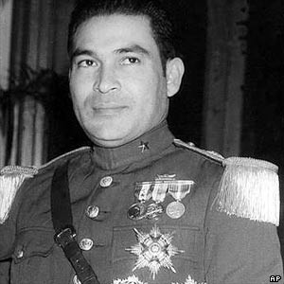
Fulgencio Batista

Slide 9
Batista’s Cuba
Fulgencio Batista had originally been elected as president, but made himself dictator of Cuba.
Many people were unhappy with Batista’s rule.
Poverty was abundant, education was poor, and healthcare was limited.
Social and economic problems helped lead to the unrest of many Cubans.
There was a small class of rich Cubans with all the power, while the majority was very poor and had little to no power.

Slide 10
Power to the People
Soon, revolutionaries lead by Fidel Castro began to rise up against the government.
Castro and his forces led an unsuccessful overthrow of the government in 1953, but began a full scale war against Batista’s government in 1955.
Castro attempted to overthrow Batista’s government for seven years.
Castro and his “army” lost many battles to Batista – he was even arrested and sentenced to 15 years in jail!
Castro was released in 1955 after serving only two years and fled to Mexico to put together a new group of rebel fighters.
By 1959, Castro and his men drove Batista and his supporters out of Havana and took over the government.

Slide 11
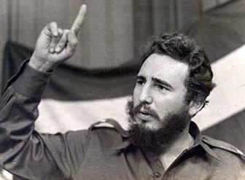
Fidel Castro

Slide 12
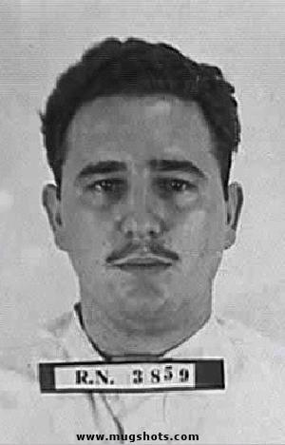
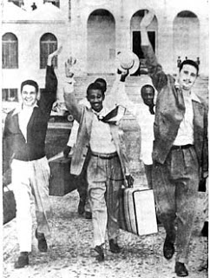
Castro Released from Prison

Slide 13
Cuban Revolution
In 1959, Castro defeated the Batista government.
Castro seized absolute power and made himself dictator of Cuba.
He then had 700 of his enemies executed and many more were thrown in prison.
The US originally backed Castro because he promised to make Cuba a democracy…
US even sent him supplies to help defeat Batista.

Slide 14
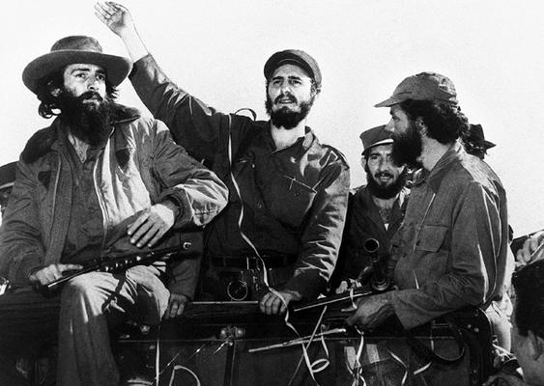
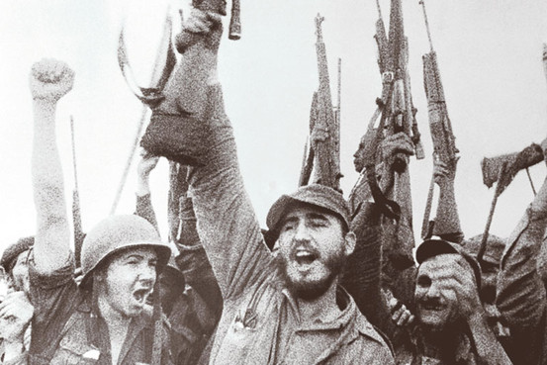

Slide 15
Castro’s Promises
Castro promised to:
end American dominance over Cuban businesses,
re-distribute the wealth evenly to all Cubans,
make every Cuban literate,
and he wanted to give all Cubans healthcare and higher life expectancy.

Slide 16
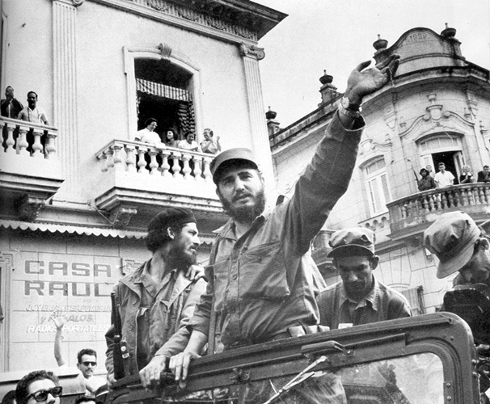

Slide 17
The Real Changes
Castro failed to do many of the things he promised he would do.
Castro began organizing a Communist government right away:
He declared that all property belonging to Americans now belonged to the Cuban government.
All farms, factories, & businesses now belonged to the government.
Cubans no longer had the right to protest against the government.
Cuban newspapers, radio, & TV were shut down.
The government became the only source for news.
Churches were closed and property was taken over by government.
Castro’s government gave less freedom to Cuba’s citizens.

Slide 18
Impact on US
It was the ultimate goal of Fidel Castro to break ties between Cuba and the United States.
After the revolution, relations between the American government and Cuban government got worse and worse.
US didn’t like having a communist country so close.
US didn’t like Cuba having ties with the Soviet Union because they were involved in the Cold War.
Americans who owned land and businesses in Cuba lost their property.
Castro forced American civilians to leave Cuba.

Slide 19
Bay of Pigs
This was a plan to arm Cuban exiles living in Florida and send them to Cuba.
Once the exiles arrived in Cuba, unhappy Cubans would join them at the Bay of Pigs and they would overthrow Castro.
The invasion was a disaster because Castro’s forces intercepted the plan and captured the invaders.
No rebellion against Castro occurred, but this sparked a deep hatred for the United States.

Slide 20
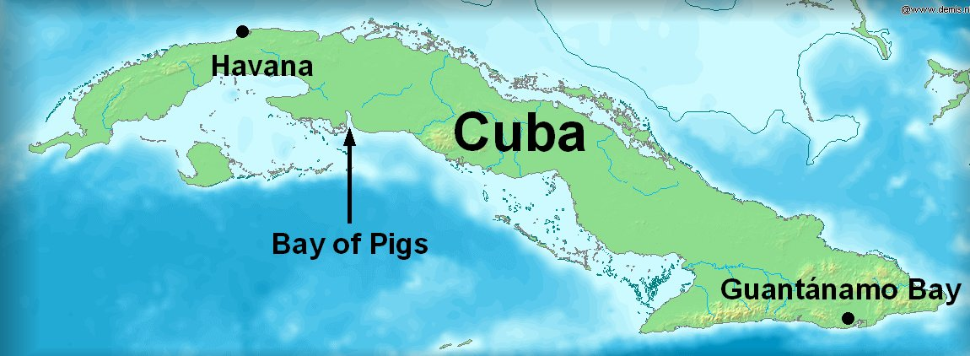

Slide 21
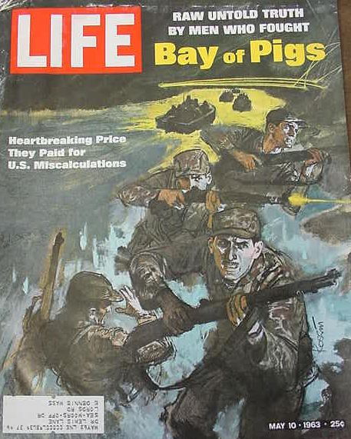
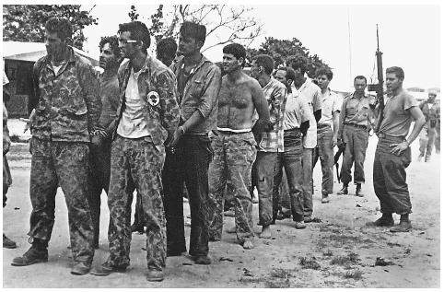
Captured During Invasion

Slide 22
Cuban Missile Crisis
In October of 1962, US planes spotted secret Soviet missile bases in Cuba.
President Kennedy announced to US citizens that the Soviets had placed long-range missiles in Cuba.
This was an extremely TENSE time (height of the Cold War) that could have led to WWIII.
Resolution:
President Kennedy agreed not to invade Cuba and to remove US missiles from Turkey; in return, Khrushchev agreed to remove the missiles from Cuba.

Slide 23
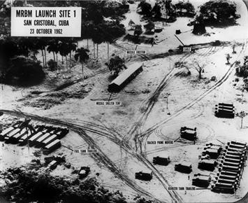
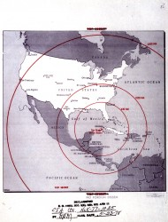
Missiles in Cuba

Slide 24
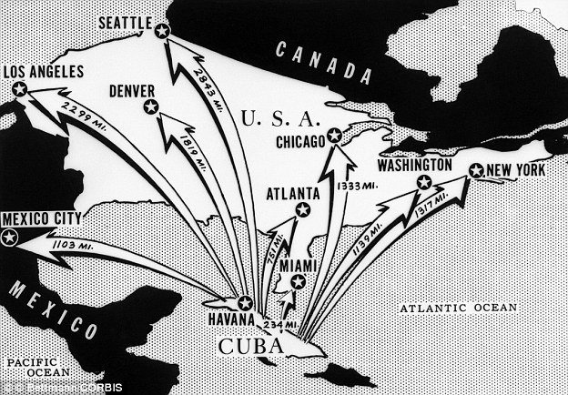
Missiles’ Range

Slide 25
US-Cuba Embargo
Due to the harsh events, US placed an embargo on goods from Cuba in 1962.
Cuba’s sugar cane crop could no longer be sold in the US, which hurt Cuba’s economy.
The embargo is still in place today.
As a result of the embargo, poor harvests, and bad government planning, Cuba’s economy has become very poor.

Slide 26
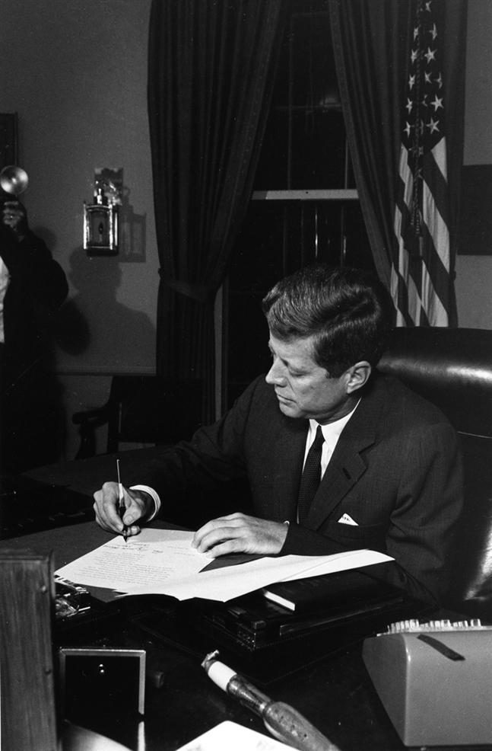
October 23, 1962: President Kennedy signs the bill to place a trade embargo on Cuba.

Slide 27
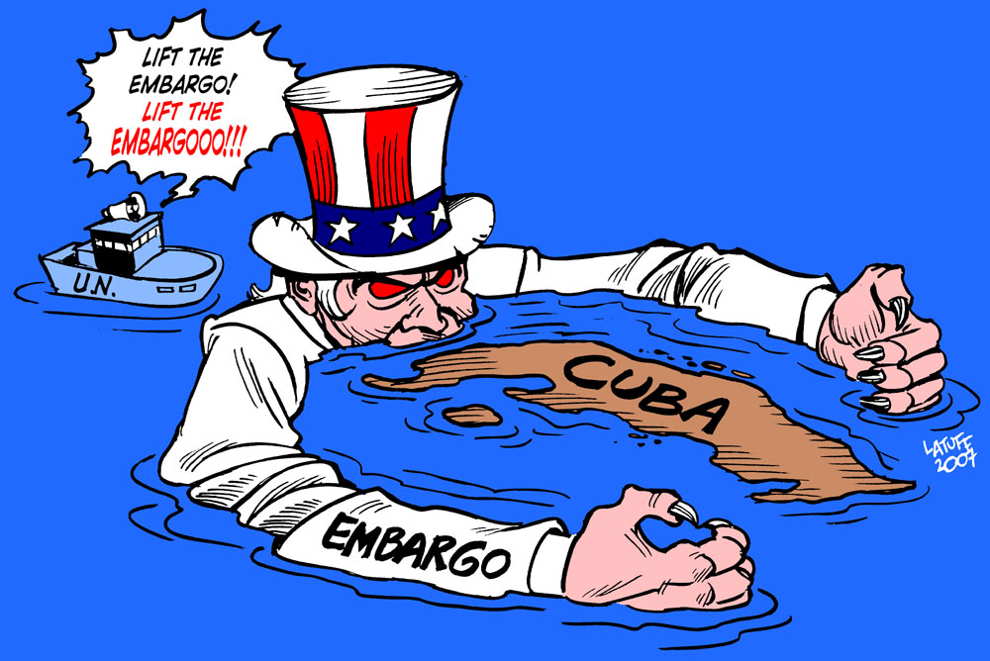

Slide 28
US & Cuba Today
Relations have not improved much over the past 50+ years.
There is still an embargo on goods to/from Cuba.
In the early 1980s and 1990s, there were periods in which large numbers of Cubans escaped their island for America.
Thousands of Cubans left because Castro would not allow free elections, freedom of speech, freedom of press, etc.

Slide 29
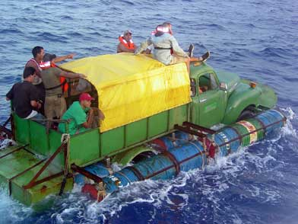
Cuban Refugees

Slide 30
Castro Today
After a decline in health, Fidel Castro gave up the Cuban presidency on February 19, 2008.
His brother, Raul Castro, is now the Cuban dictator.
Most Cubans despise the Castro regime, but are too afraid to oppose the government.

Slide 31
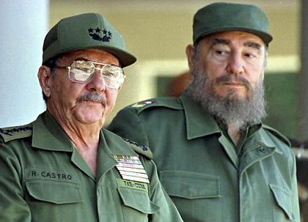
Raul & Fidel Castro

Slide 32
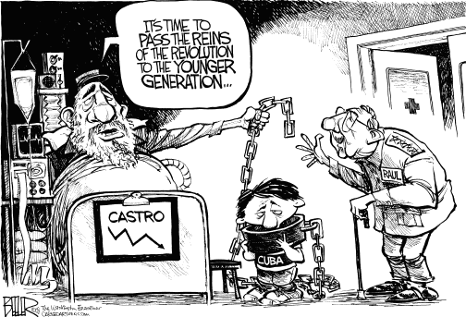

Slide 33
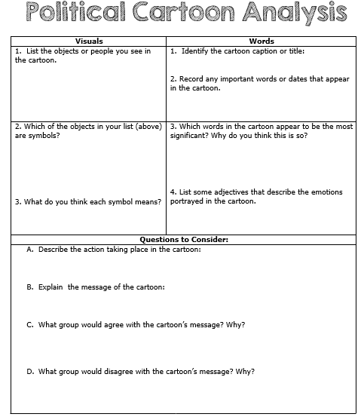

Slide 34
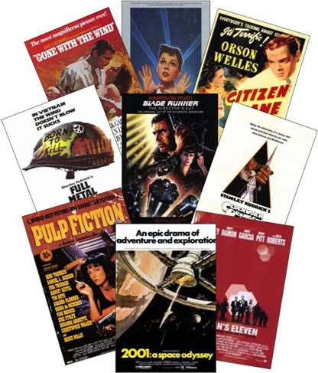
Movie Poster Directions
POSTER -- Draw and color your poster. It must include:
An image or scene that represents the “movie”
The title of the movie—“The Cuban Revolution” (or something similar)
The “actors” in the movie – (“starring Fidel Castro”, etc.)
REVIEW – Answer the following questions on the back of your poster. Please write in complete sentences!
Summarize the Cuban Revolution.
Summarize the main people involved in the Cuban Revolution.
Give your opinion of the Cuban Revolution.
How many “stars” out of 4 would you give it? Why?

Slide 35
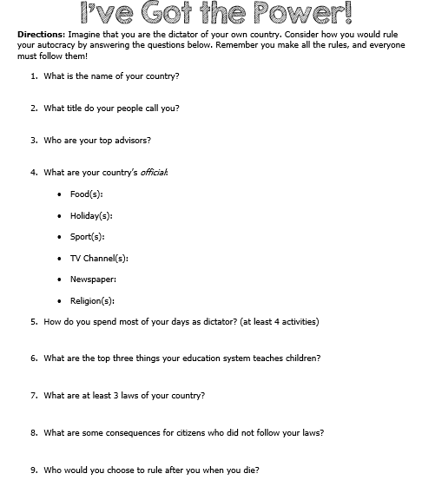

Slide 36
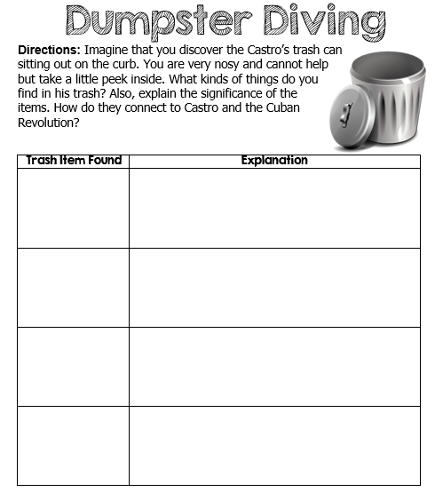

Slide 37
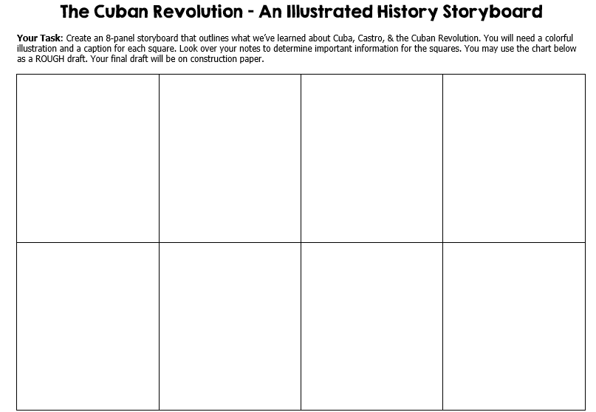

Slide 38
Teachers – Castro Mini-Centers Directions
Put the students into six groups. Print off the Center slides. The students will rotate through the six centers and complete the graphic organizer.

Slide 39
Castro Mini-Centers
Your Task: Rotate through each Castro Center and complete the graphic organizer. You will only have about 5 minutes at each center, so work quickly!
Center Guidelines:
1. Keep all materials at the table.
2. You may only talk with people in your group.
3. Write all of your answers on the graphic organizer,
4. When the timer goes off, it’s time to move to the next center.
5. Turn in your graphic organizer for a grade!

Slide 40
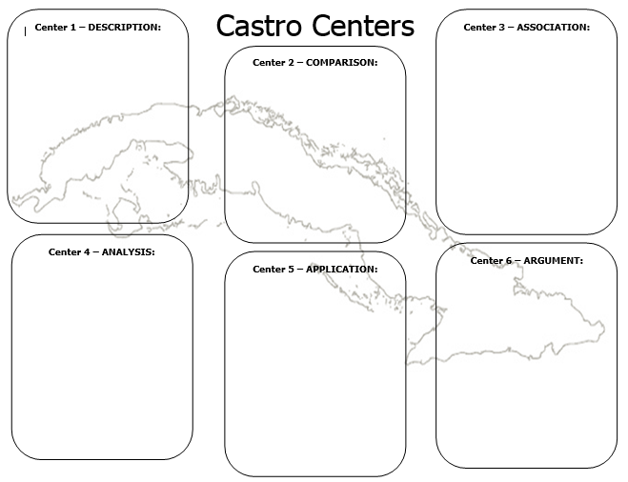

Slide 41
Center 1 - Description

Slide 42
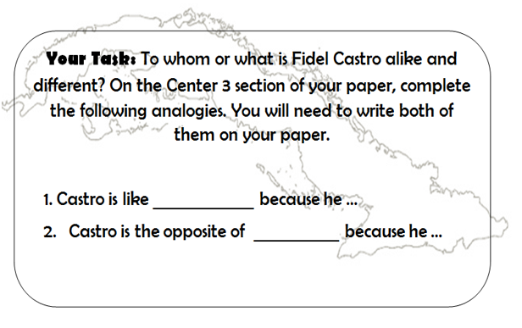
Center 2 - Comparison

Slide 43
Center 3 - Association

Slide 44
Center 4 - Analysis

Slide 45
Center 5 - Application

Slide 46
Center 6 - Argument

Slide 48
Teachers
Thank you for downloading this file. I hope you enjoy using it with your students, and I can’t wait to read your feedback in my TPT store! ☺
For more social studies materials, please visit my store: http://www.teacherspayteachers.com/Store/Brain-Wrinkles
I teach Language Arts and Social Studies in Georgia, so my products are aligned with Common Core (LA) and Georgia Performance Standards (SS).
© Copyright 2013. Brain Wrinkles. All rights reserved. Permission is granted to copy pages specifically designed for student or teacher use by the original purchaser or licensee. The reproduction of any other part of this product is strictly prohibited. Copying any part of this product and placing it on the Internet in any form (even a personal/classroom website) is strictly forbidden. Doing so makes it possible for an Internet search to make the document available on the Internet, free of charge, and is a violation of the Digital Millennium Copyright Act (DMCA).

Slide 49
Credits:
All photos were found via Creative Commons and labeled for reuse.
Fonts:
Backgrounds & Graphics:

