Slide 1
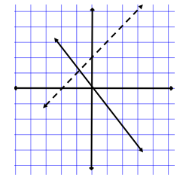
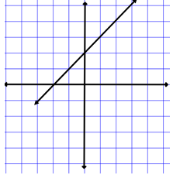
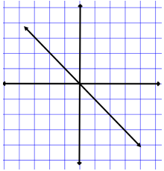
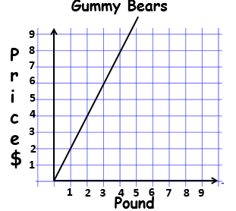
Proportionality of Graphs Guided Notes
Name _____________________ Date _______________
The black line is proportional. The dotted line is not proportional.
How are these lines alike? Different?
Example 1:
Is the graph proportional?
What is the constant of proportionality?
Example 2:
Is the graph proportional?
What is the constant of proportionality?
Example 3:
What is the constant of proportionality for the graph?
What does it mean?
What does the ordered pair (0,0) mean?
TeacherTwins©2016

Slide 2
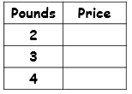
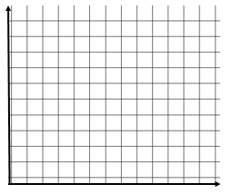
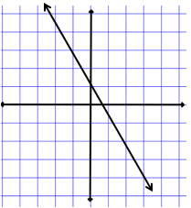
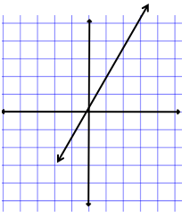
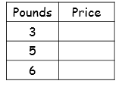
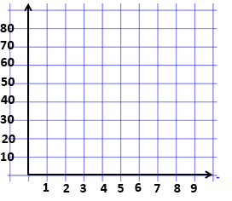
Proportionality of Graphs Guided Notes
Name _______________________ Date ___________________
Example 4:
Kim bought one pound of grapes for $1.50. How much will she pay for 2, 3, and 4 pounds of grapes?
Write the equation.
Graph the equation.
Tell if it is proportional and give
the constant of proportionality.
Practice
Tell if the graph is proportional and give the constant of proportionality.
1). 2).
3). Stephen can ride 12 miles in one hour on his bike. How many miles will he ride in 3, 5, and 6 hours?
Write the equation.
Graph the equation.
Tell if it is proportional and give
the constant of proportionality.
TeacherTwins©2016

