Slide 1
Fractions, Decimals and Percent
TeacherTwins©2015

Slide 2
Warm Up
Tell the fraction, decimal and percent for each model.
1). 2).
26%, 0.26, $\frac{13}{50}$
13%, 0.13, $\frac{13}{100}$

Slide 3
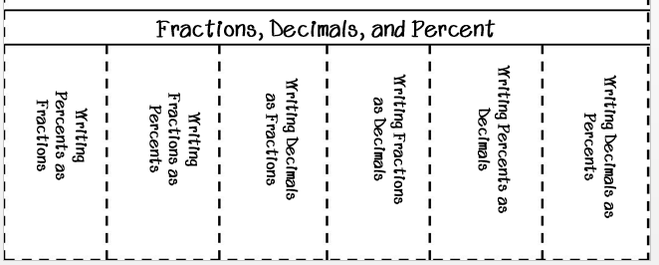
Fraction, Decimal, Percent Flippable

Slide 4
Writing Decimals as Percents
Multiply the decimal by 100.
Ex: 0.2 0.2 x 100 = 20%

Slide 5
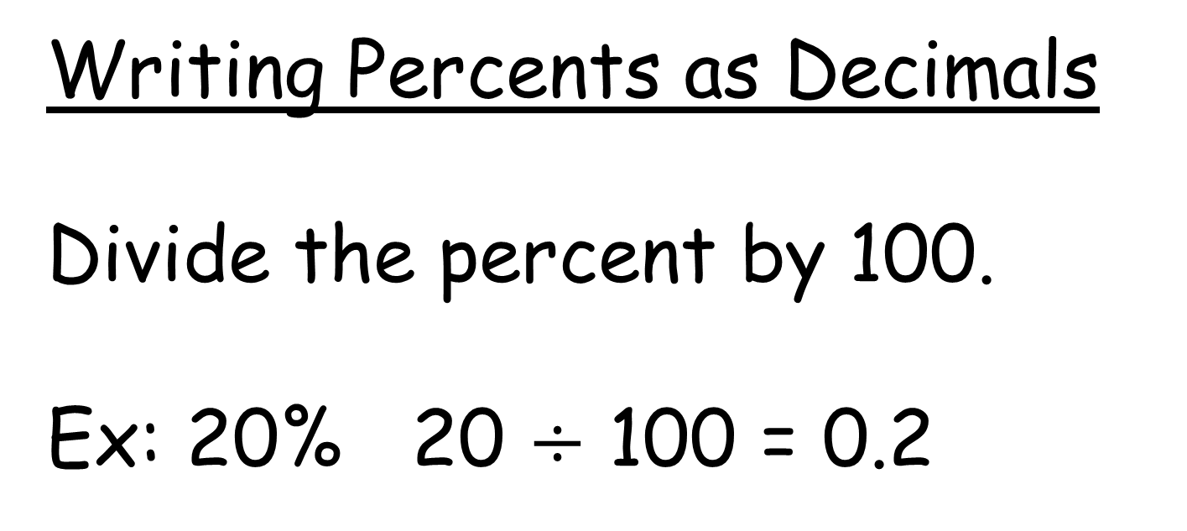
Writing Percents as Decimals
Divide the percent by 100.
Ex: 20% 20 $÷$ 100 = 0.2

Slide 6
Writing Fractions as a Decimal
Divide the numerator by the denominator.
Ex: ¾ 3 $÷$ 4 = 0.75

Slide 7
Writing Decimals as Fractions
Use place value to write decimal as a fraction. Then simplify.
Ex: 0.75 is 75 hundredths or 75/100.
75/100 = ¾

Slide 8
Writing Fractions as Percents
Change the fraction to a decimal and then multiply by 100.
Ex: 4/5 4 $÷$ 5 = 0.8
0.8 x 100 = 80%

Slide 9
Writing Percents as Fractions
Write the percent as a fraction over 100. Then simplify.
Ex: 80% 80/100 = 4/5

Slide 10




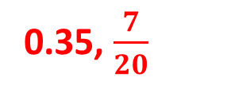
Practice
Write each percent as a fraction and a decimal.
1). 35% 2). 67.8% 3). 41%
Write the decimal as a fraction and a percent.
4). 0.29 5). 3.45 6). 0.678
Write each fraction as a decimal and a percent.
7). $\frac{3}{5}$ 8). $\frac{1}{2}$ 9). $\frac{7}{8}$
0.35, $\frac{7}{20}$
0.678, $\frac{339}{500}$
0.41,$\frac{41}{100}$
29%, $\frac{29}{100}$
345%, 3$\frac{9}{20}$
67.8%, $\frac{339}{500}$
0.60, 60%
0.50, 50%
0.875, 87.5%

Slide 11
Closure
Change the following fraction to a decimal and a percent.
$$\frac{3}{8}$$
37.5% and 0.375

