Slide 1
Number Order vs. Absolute Value

Slide 2
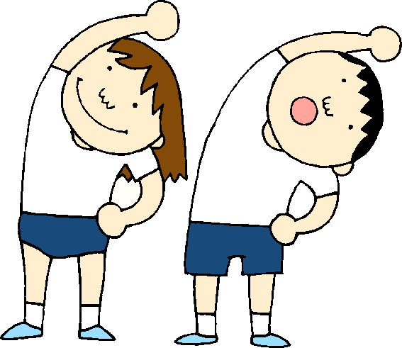
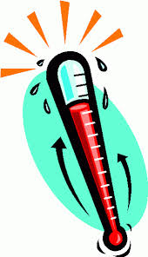
Warm Up
Learning Objective: Students Will Be Able To…Distinguish comparisons of absolute value from
statements about order.
How many halves, (1/2), are there in an
eighth, (1/
In the prior lessons, we learned about relative sizes of quantities, absolute value, and magnitude. The key is to know when to utilize one vs. another. Often times, it’s the words around the math, the Context, that can make this tricky.
Wednesday’s Temperature 85º F
Thursday’s Temperature 75º F
2 of the statements below are accurate and 2 are not, label each appropriately.
Inaccurate
The temp. decreased by -10º
The temp. decreased by 10º
The change in temp. was -10º
The change in temp. was 10º
Accurate
Accurate
Inaccurate
Agenda

Slide 3
Lesson Vocabulary and Language Objectives
Word | Definition
Context (math specific definition) | The circumstances surrounding a problem that determine actions necessary to solve
Increase | Going up, assumes that the quantity is positive, the word increase takes the place of the positive sign
Decrease | Going down, assumes the quantity is negative, the word decrease takes the place of the negative sign
Agenda

Slide 4
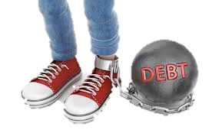
Launch – Get your Context Straight
Joey owes a credit card company $150 for sneakers that he purchased with his credit card.
Numerically, how would you represent his debt?
-$150
Verbally, how would you say this?
Joey owes $150 dollars.
Joey is $150 in debt.
In the verbal scenario, the absolute value of -150 is used. This is because the words “owe” and “debt” are the context that indicate negative. Since they represent negative…there is no need to include the negative sign.
Agenda

Slide 5
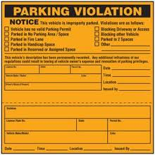
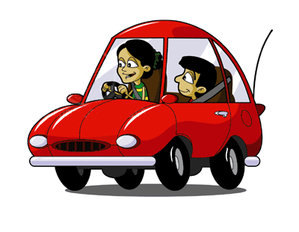
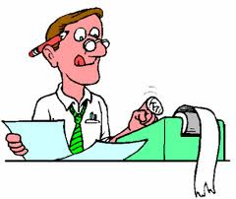
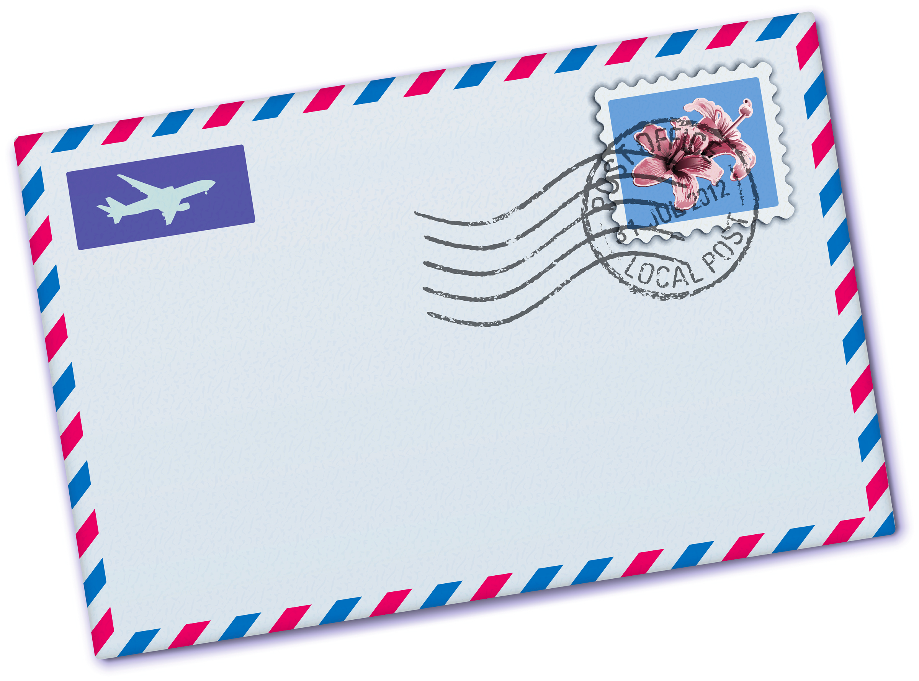
Explore 1 – Get your Context Straight
Joey has received numerous parking tickets because he forgets to pay the meters. His tickets sum to $225.
1) How would an accountant, a person who tracks money numerically, working at the parking office write the amount Joey owes?
Accountant
-$225
2) If a letter is sent to Joey’s home indicating what he owes, what would it say?
You owe $225
You have a debt of $225
Agenda

Slide 6
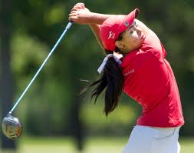
Explore 2 – Scoring in the context of Golf
In the sport of golf, having a low/small score is better than having a high/large score. A score of zero is known as par.
Woods | -8
Mickelson | -4
Mcilroy | -2
Goosen | 1
Scott | 7
Couples | 10
Garcia | 15
3) If you knew nothing about golf and its context, who would you think won this tournament?
4) A) Who has a greater absolute value (magnitude from par),
Mcilroy or Couples?
B) Who played a better round of golf?
5) By how many strokes did Woods beat Garcia?
Garcia
Couples
B) Mcilroy
+
= 23
-8
0
15
Agenda

Slide 7
Explore 3 – Rapid Response….
6) Between shopping and tickets Joey has a debt of $375. Numerically, give a debt amount greater than $375
7) Numerically, how would you write a loss of 20 lbs in weight?
8) Verbally, how would you write a -$5,000 change in a home’s price?
9) If West is a negative direction and East is positive. How many miles does someone run if they go from a position 7 miles West and finish 4 miles East?
10) Numerically, supply a debt amount that is less than $100.
11) True/False…Magnitudes are negative values.
12) True/False… 12 is greater than 10 and a debt of 12 is greater than a debt of 10.
*Greater means greater debt, not larger number
*Think of number line with West negative and East positive
*Less debt does mean greater number
Agenda

Slide 8
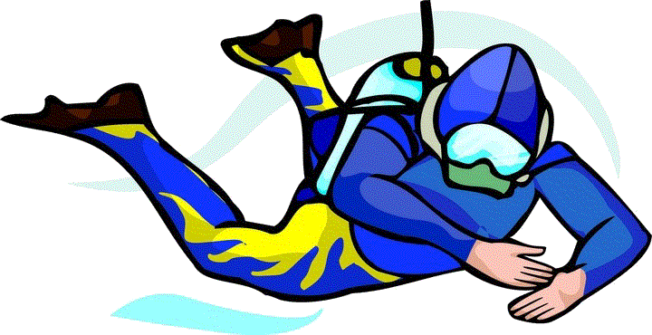
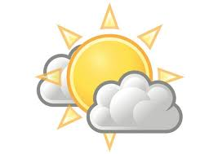
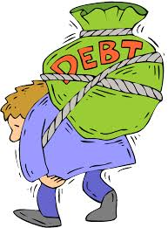
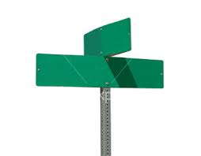
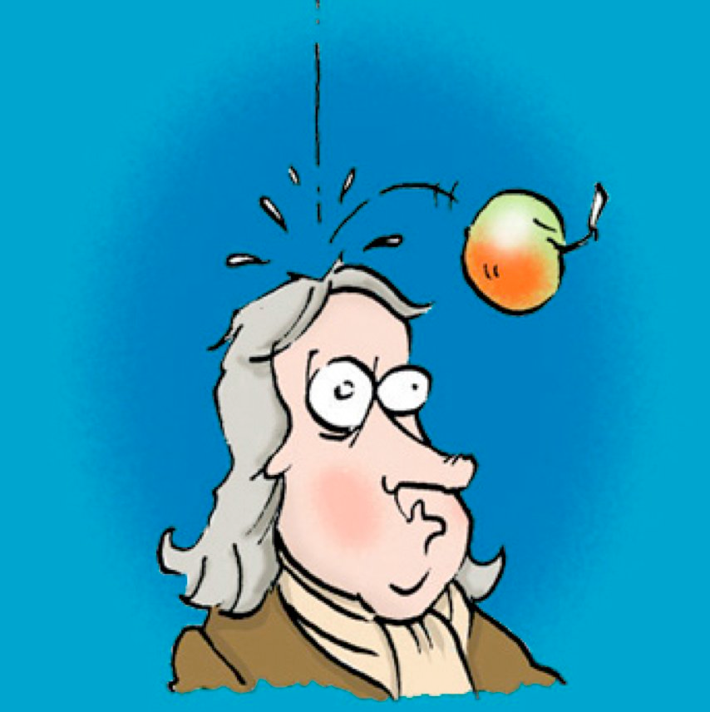
Explore 4 – Context creation….
Use the picture, number, and words provided to create context (a written statement)
Ex) -10, below
A scuba diver was 10 ft below the water surface.
13) -7, decrease
14) -24, absolute value
15) -$1,500 and -$2,000, greater magnitude
W 24th Street
16) -9.8, gravity, fall
Agenda

Slide 9
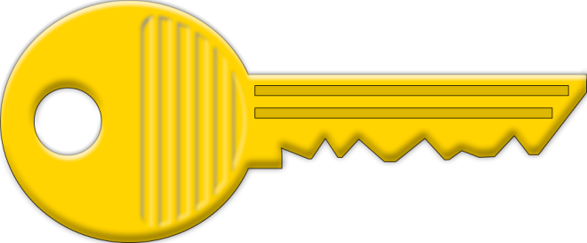
Assessment
Name:__________ Key to Leave
# Correct
Place the phrases/numbers in order from least to greatest.
decreased by 3.8
dropped 4.9
increased by 7.1
gained 3.4
absolute value of -8
magnitude of 5
absolute value of 8.1
6 dollars in debt
at most -3
at least 10
Least
6 dollars in debt
dropped 4.9
decreased by 3.8
at most -3
gained 3.4
magnitude of 5
increased by 7.1
absolute value of -8
absolute value of 8.1
Greatest
at least 10
Agenda

