Slide 1
Early Civilizations
of
Latin America

Slide 2
Fall of the
Aztec &
Incan Empires

Slide 3
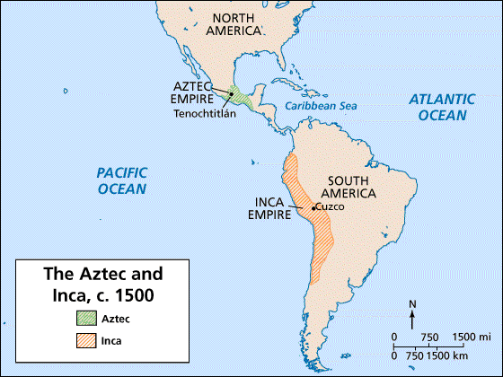

Slide 4
Let’s Review
Discuss with your Elbow Buddy:
Describe the Incan Empire.
Describe the Aztec Empire.
How are they similar and different?

Slide 5
Spain Vs. Portugal
Christopher Columbus asks both countries to sponsor his voyage--Spain agrees.
Portugal soon saw the wealth that Spain was gaining, and wanted to be part of the action.
The two countries became rivals and tried to stop each other from claiming land in the Americas.

Slide 6
Spain Vs. Portugal
In 1494, the countries signed Treaty of Tordesillas.
This set the Line of Demarcation (imaginary line from the North Pole to the South Pole at 50 degrees longitude).
Spain got everything to the west, while Portugal got everything to the east.
What language is spoken in most of Latin America today?
What language is spoken in Brazil?

Slide 7
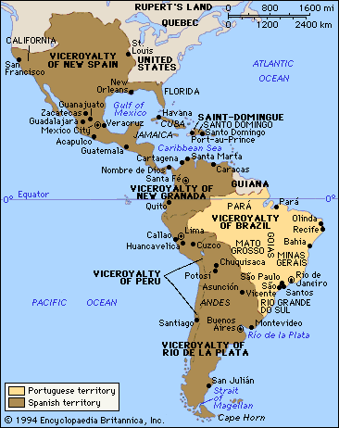
Aztec Temple

Slide 8
Spanish Conquistadors
“Conquistadors” = soldier-explorers who settled in the Americas in hopes of finding treasure
They were inspired by Columbus to seek fortune in the New World.
Many came from the part of Spain called Extremadura.
Poor soil, icy winters, & blistering hot summers held little chance for wealth.
Hernan Cortes and Francisco Pizarro were born in this province.

Slide 9
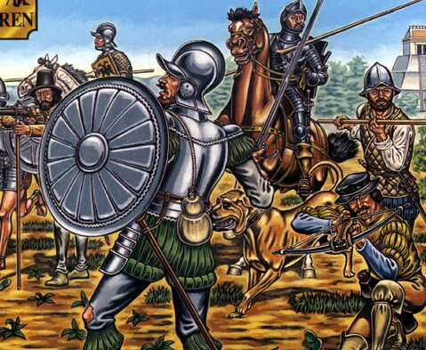
What are some words that describe us?
Aztec Temple
Terrace Farming

Slide 10
Fall of
the Inca

Slide 11
The Inca
In the 1530s, the Incan empire was HUGE!
Inca thought they ruled most of the world; two threats from the north soon proved they did not...
1.They couldn’t stop the spread of smallpox.
2. They couldn’t scare away Pizarro.

Slide 12
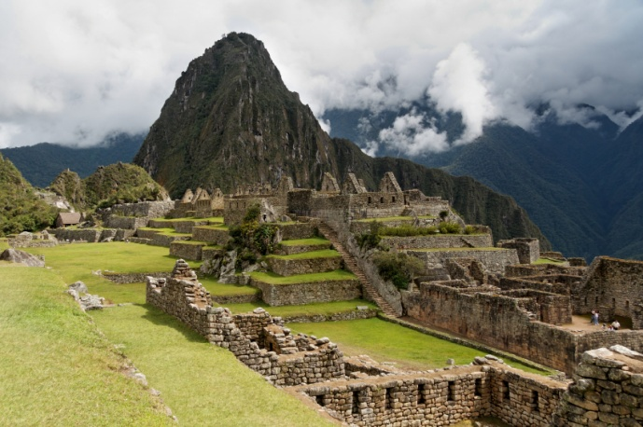
Aztec Temple
Terrace Farming

Slide 13
Francisco Pizarro
Pizarro was from the Extremadura.
He was not of noble birth; could not even write his name.
At age 16, Pizarro fled a job herding pigs in Italy.
In 1502, he arrived in the Americas and became very wealthy by exploring Panama.
He heard a rumor that there was a great empire filled with gold in the mountains of South America…

Slide 14
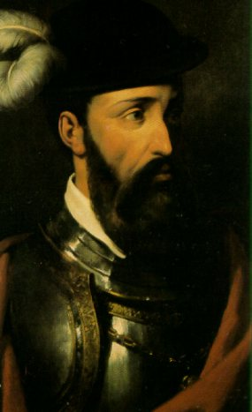

Slide 15
Pizzaro
GPS Video Clip : 4:45

Slide 16
Pizzaro & the Inca
Pizarro led 160 soldiers to the Incan homeland.
They raided Incan storehouses & fired guns at villagers.
Incan emperor, Atahualpa, thought Pizarro was crazy. How could he stand up to an army of 80,000 Incan warriors?
In 1532, Pizarro came up with a plan to defeat the Inca...

Slide 17
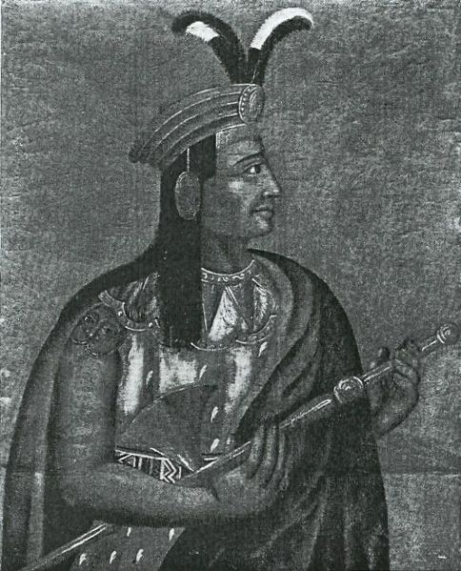
Atahualpa

Slide 18
Atahualpa
GPS Video Clip : 4:09

Slide 19
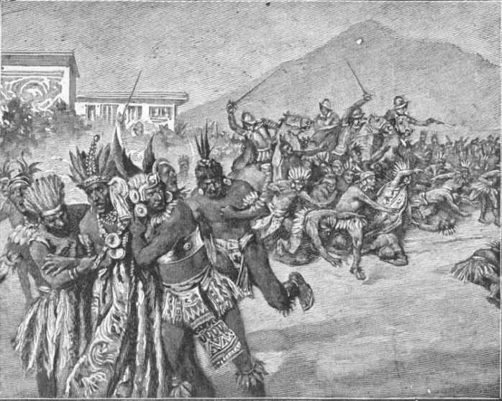
Aztec Temple
Terrace Farming

Slide 20
Pizzaro Defeats the Inca
Spanish messengers invited Atahualpa to a meeting.
He agreed & left most of his army behind--brought only 5,000 bodyguards.
Pizarro’s 160 soldiers attacked the Inca & kidnapped Atahualpa.
Pizarro offered to free Atahualpa if he filled one room with gold & one with silver.
Atahualpa kept his end of the bargain, but Pizarro killed him in 1533.

Slide 21
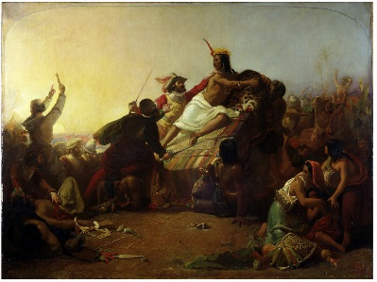
Aztec Temple
Terrace Farming

Slide 22
After Conquering the Inca
The Spanish king made Pizarro the governor of Peru.
Pizarro’s conquest of Peru opened most of South America to Spanish rule.
Spain controlled a vast territory covering 375,000 miles with almost seven million inhabitants.

Slide 23
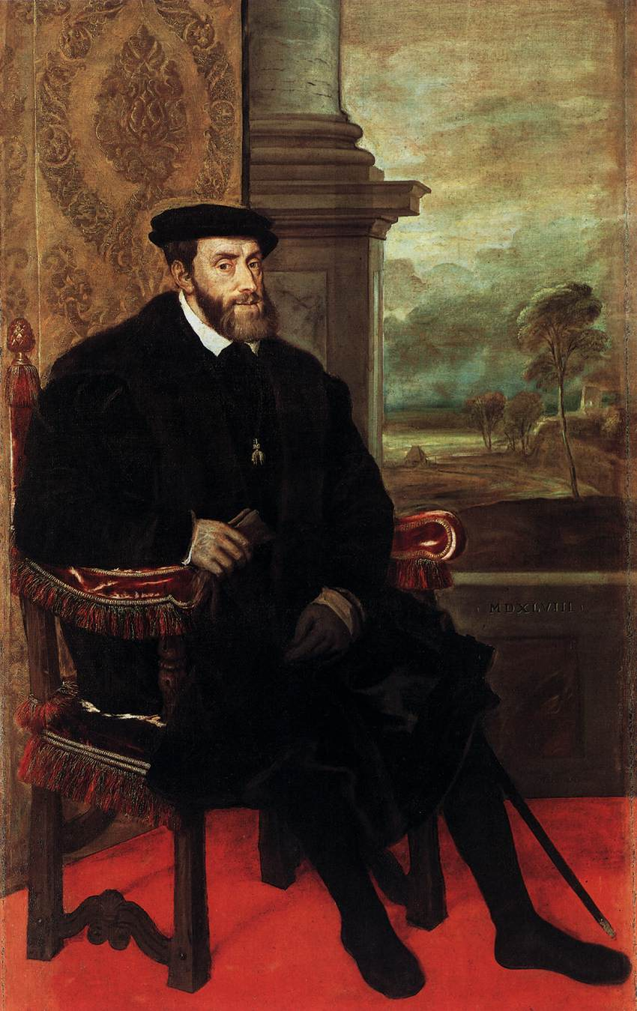

Slide 24
Fall of
the Aztec

Slide 25
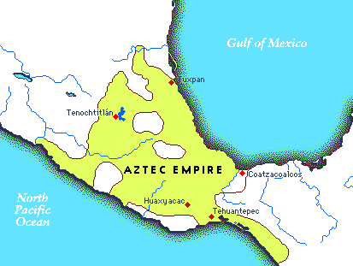

Slide 26
Hernan Cortes
Cortes was a Spanish conquistador who reached Mexico in 1519 in search of treasure.
He arrived in Mexico with only 550 soldiers, 16 horses, 14 cannons, & a few dogs.
His group was met by Aztec emperor, Montezuma II…

Slide 27
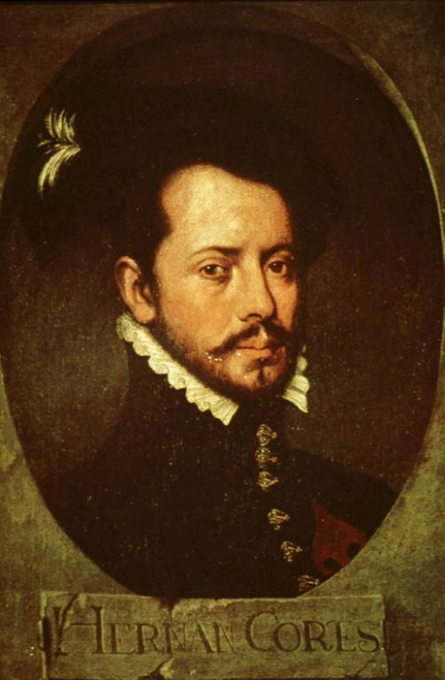

Slide 28
Hernan Cortes
GPS Video Clip: 4:16

Slide 29
Cortes Invades Mexico
How could such a small force conquer a huge empire?
1. Cortes knew how to use Spanish horse and guns to shock Aztecs.
2. Malintzin (a Mayan woman) gave Cortes the inside scoop on the Aztec empire & helped him form alliances against Montezuma.
3. Cortes had invisible help--diseases that killed more Aztecs than Spanish swords.
4. Montezuma believed Cortes to be Quetzalcoatl--an important Aztec god.

Slide 30
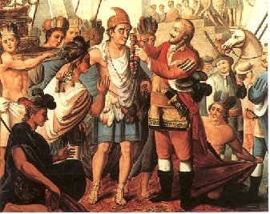

Slide 31
Montezuma II
GPS Video Clip: 4:59

Slide 32
Cortes Defeats Aztecs
Cortes traveled 400 miles to reach Tenochtitlan.
Montezuma did not attack right away because he first thought Cortes was Quetzalcoatl.
The Spanish were able to take control of the city & took Montezuma hostage.
Cortes ordered the Aztec to stop sacrificing people.

Slide 33
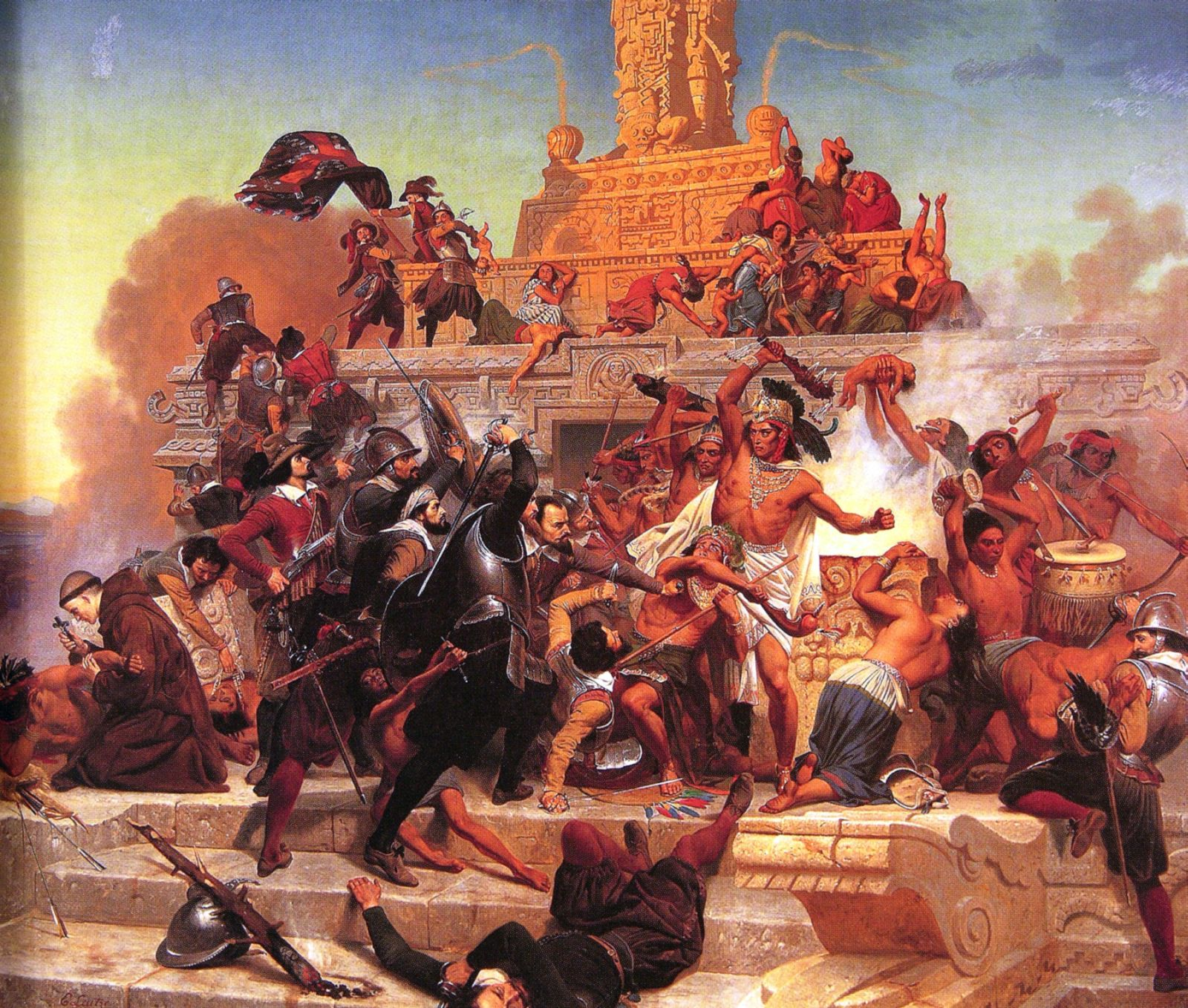
Aztec Temple

Slide 34
Cortes Defeats Aztecs
Cortes’ orders angered the Aztecs, so they planned a rebellion.
Fighting broke out & Montezuma was killed.
The Spanish were outnumbered, so they fled the city.
Before they could prepare a 2nd attack, smallpox broke out in Tenochtitlan & greatly weakened the large Aztec empire.
In 1521, the Spanish destroyed the Aztec capital.

Slide 35
After Conquering the Aztec
Cortes took part in one more expedition to Honduras.
He served as Governor General of New Spain.
He returned to Spain a very wealthy man.
He died in Seville, Spain in 1547.

Slide 36
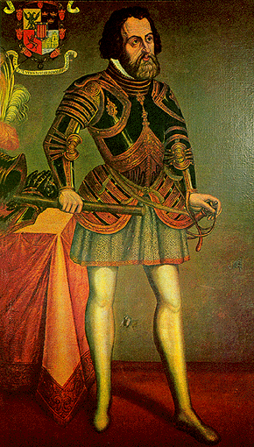

Slide 37
HIS-story
Your Task: Imagine that you are one of the following men: Hernan Cortes, Montezuma, Francisco Pizarro, or Atahualpa.
Write a journal entry that details the experience of the man on the day that the corresponding civilization fell.

Slide 38
