Slide 1
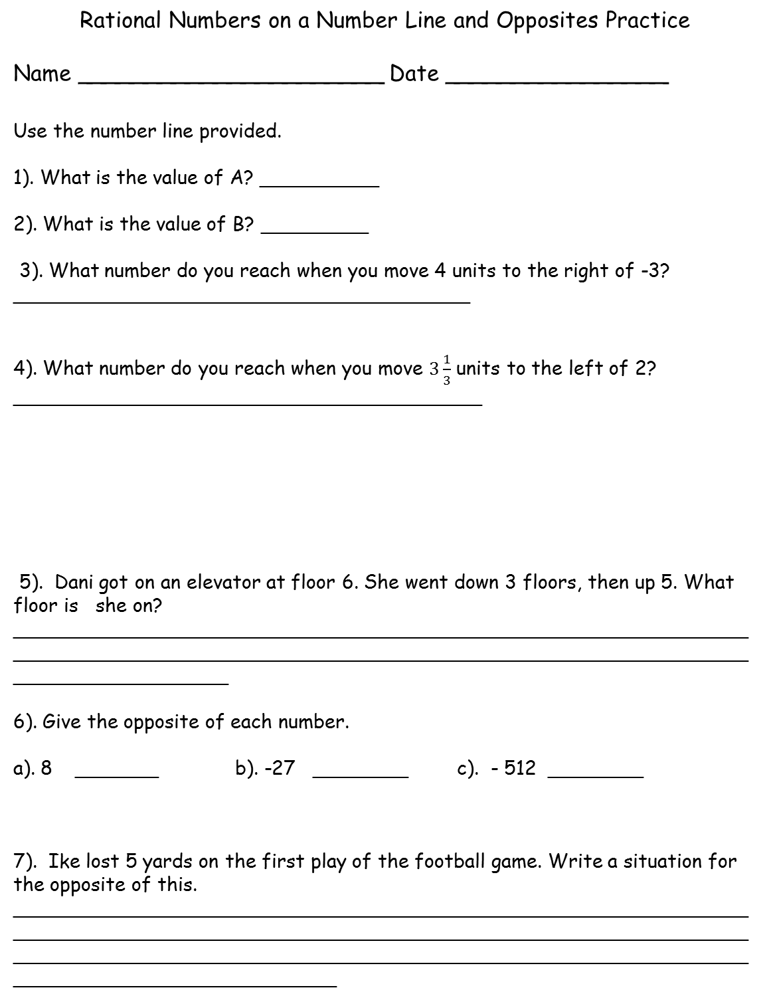
Rational Numbers on a Number Line and Opposites Practice
Name ______________________ Date ________________
Use the number line provided.
1). What is the value of A? __________
2). What is the value of B? _________
3). What number do you reach when you move 4 units to the right of -3? ______________________________________
4). What number do you reach when you move $3\frac{1}{3}$ units to the left of 2? _______________________________________
5). Dani got on an elevator at floor 6. She went down 3 floors, then up 5. What floor is she on? ____________________________________________________________________________________________________________________________________________
6). Give the opposite of each number.
a). 8 _______ b). -27 ________ c). - 512 ________
7). Ike lost 5 yards on the first play of the football game. Write a situation for the opposite of this. __________________________________________________________________________________________________________________________________________________________________________________________________________________
A
B
TeacherTwins©2015

