Slide 1
Surface Area of Prisms
TeacherTwins©2014

Slide 2
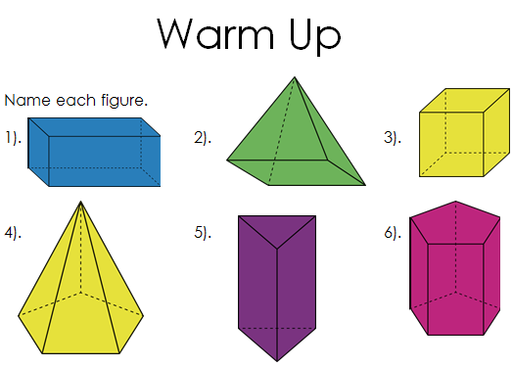
Rectangular Prism
Square pyramid
cube
Pentagonal pyramid
Triangular prism
Pentagonal prism

Slide 3
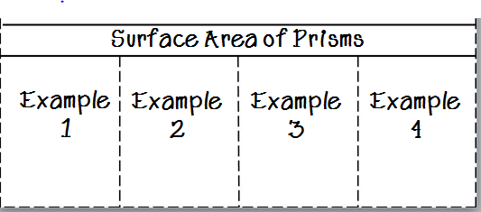
Flippable

Slide 4
How to find surface area of a rectangular prism.
Example 1
2 in
8 x 4 = 32
8 x 4 = 32
4 in
8 x 2 = 16
8 x 2 = 16
8 in
4 x 2 = 8
4 x 2 = 8
112 ${in}^{2}$

Slide 5
How to find surface area of a rectangular prism.
Example 2
Shortcut
You can find the area of half of a rectangular prism and multiply by 2 .
3 in
6 in
12 x 6 = 72
12 x 3 = 36
12 in
3 x 6 = 18
126 x 2 = 252 ${in}^{2}$

Slide 6
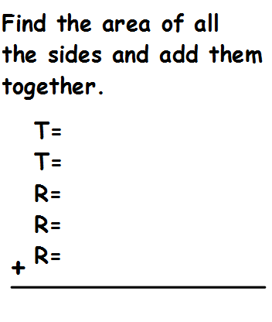
How to find surface area of a triangular prism.
Example 3
8 ft
6 ft
$$\left(9×6\right)÷2=27$$
$$\left(9×6\right)÷2=27$$
14 ft
9 x 14$=126$
8 x 14$=112$
9 ft
8 x 14$=112$
404 ${ft}^{2}$

Slide 7
How to find surface area of a triangular prism.
Example 4
3 cm
3 cm
4 cm
$\left(4 ×3\right)÷2=$6
$$\left(4 ×3\right)÷2=6$$
10 cm
$$3 ×10=30$$
$$3 ×10=30$$
3 cm
3 $×10=30$
102 ${cm}^{2}$

Slide 8
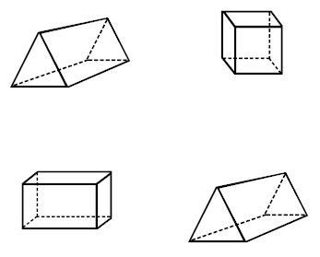
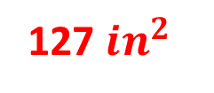
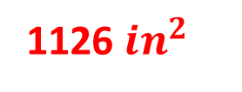
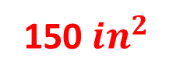
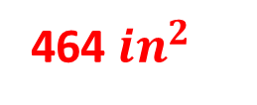
Practice
Find the surface area of each figure.
10 in
1).
2).
8 in
5 in
16 in
150 ${in}^{2}$
464 ${in}^{2}$
8 in
3).
25 in
4).
2 in
4 in
11 in
8 in
1126 ${in}^{2}$
9 in
127 ${in}^{2}$
5 in

Slide 9
Closure
How is finding surface area of a rectangular prism and a triangular prism alike? Different?

