Slide 1
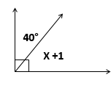
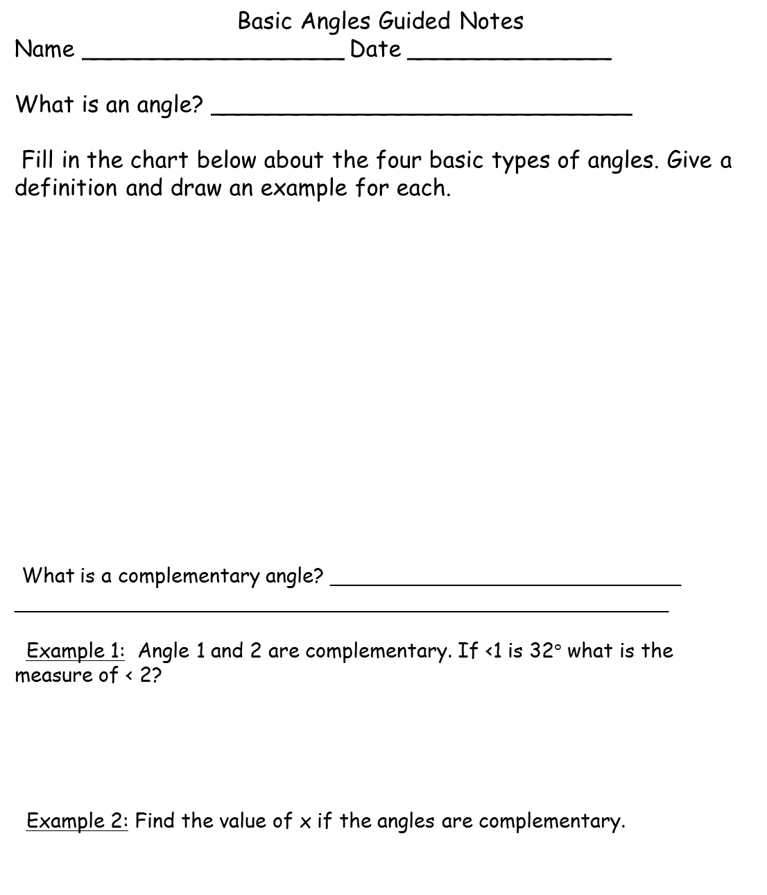
Basic Angles Guided Notes
Name __________________ Date ______________
What is an angle? _____________________________
Fill in the chart below about the four basic types of angles. Give a definition and draw an example for each.
What is a complementary angle? ____________________________
____________________________________________________
Example 1: Angle 1 and 2 are complementary. If <1 is 32$°$ what is the measure of < 2?
Example 2: Find the value of x if the angles are complementary.
Acute Angle | Right Angle
Obtuse Angle | Straight Angle
TeacherTwins©2016

Slide 2
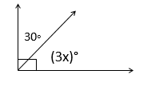
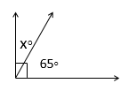
Basic Angles Guided Notes
What is a supplementary angle? ________________________________
__________________________________________________________
Example 1: Angle 3 and angle 4 are supplementary. If < 4 is 126°, how many degrees is < 3?
Example 2: Angle 1 and angle 2 are supplementary. If < 1 is 52° and < 2 is
(2x + 2)°, what is the value of x? How many degrees is angle 2?
Practice
Identify the pairs of angles as complementary or supplementary or neither.
1). 45° and 54° 2). 136° and 44° 3). 76°and 104° 4). 26° and 64°
Find the value of “x” for each figure.
5). 6).
7). 8).
TeacherTwins©2016

