Slide 1
Scientific Notation
Teacher Twins©2014

Slide 2
Warm Up
Simplify.
($x^{7}$)($x^{8}$)
($x^{8}$) ÷ ($x^{5}$)
($x^{7}$)⁶
$x^{−5}$

Slide 3
Warm Up Answers
$x^{15}$
$x^{3}$
$x^{42}$
$\frac{1}{x^{5}}$

Slide 4
Scientific Notation

Slide 5
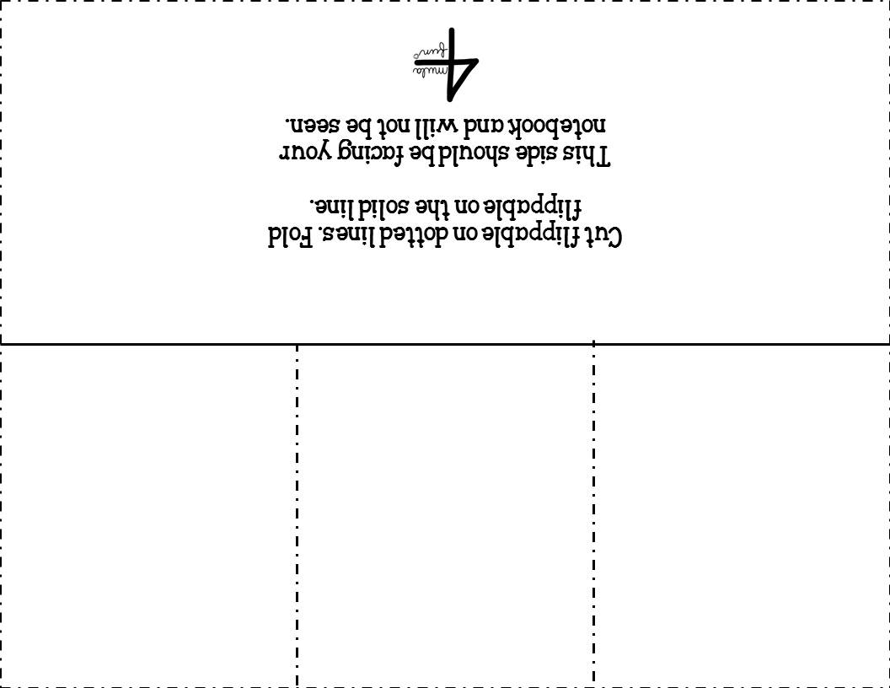
Writing numbers in scientific notation.
Writing numbers that are in scientific notation in standard form.
What is scientific notation?

Slide 6
Scientific notation is written as the product of a
factor and a power of ten.
Inside flap- What is scientific notation?
Scientific notation is a way to write numbers that are too big or too small to write as a decimal.
Scientific notation is written as the product of a factor and a power of ten.
The factor must be greater than or equal to 1 and less than 10.

Slide 7
Inside Flap- Writing numbers that are in scientific notation in standard form.
_{Write 4.35 x 10}⁴ _{in standard form.}
4.35 x 10⁴ = 4.35 x 10,000 = 43,500
${10}^{4}$= 10x10x10x10 or 10,000
Notice that the decimal point moves four places to the right.

Slide 8
Inside Flap- Writing numbers that are in scientific notation in standard form.
Write 2.32 x 10⁻³ in standard form.
2.32 x 10⁻³ = 2.32 x 0.001
Notice that the decimal point moves 3 places to the left.

Slide 9
Inside Flap – Writing numbers in scientific notation
Write 3,456,000 in scientific notation.
3.456 x 10⁶
The decimal point moves 6 places.
The first factor
must be $≥$ 1 and
< 10.
Write 0.0096 in scientific notation.
9.6 x ${10}^{−3}$ The decimal move 3 places. The power is negative because the number is less than 1.

Slide 10
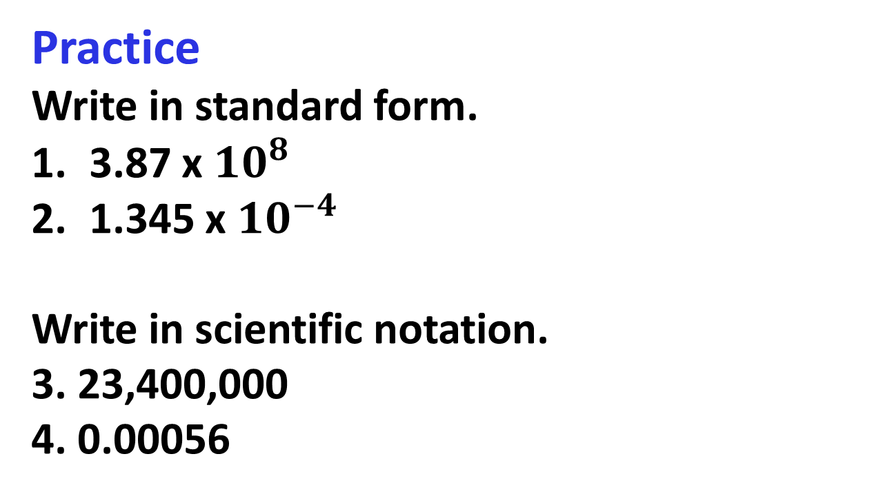
Practice
Write in standard form.
3.87 x ${10}^{8}$
1.345 x ${10}^{−4}$
Write in scientific notation.
3. 23,400,000
4. 0.00056

Slide 11
Closure
Write in standard form.
5.6 x ${10}^{5}$
Write in standard form.
0.0000075

