Slide 1
Multiplying Fractions
TeacherTwins©2015

Slide 2
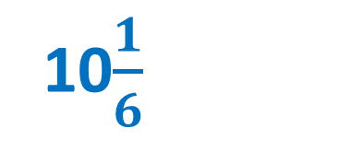
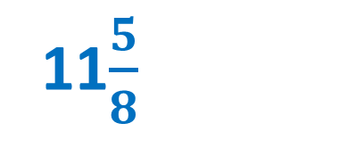
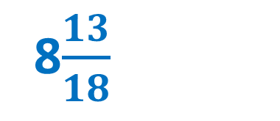
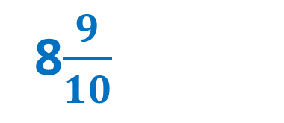
Warm Up
Add. Write the answer in simplest form.
10$\frac{3}{5}$ - 1$\frac{7}{10}$ 2. 15$\frac{8}{9}$ - 7$\frac{1}{6}$
3. 13$\frac{2}{3}$ - 2$\frac{1}{24}$ 4. 24 - 13$\frac{5}{6}$
8$\frac{9}{10}$
8$\frac{13}{18}$
11$\frac{5}{8}$
10$\frac{1}{6}$

Slide 3

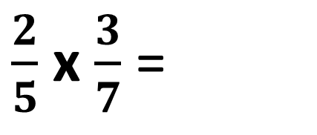
Example 1: Multiply $\frac{2}{5}$ x $\frac{3}{7}$
Multiply numerators and multiply denominators.
$$\frac{6}{35}$$
$\frac{2}{5}$ x $\frac{3}{7}$ =

Slide 4
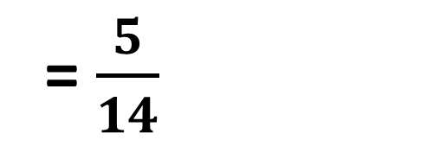
Example 2: Multiply $\frac{2}{5}$ x $\frac{25}{28}$
Simplify the fraction by dividing by the GCF.
$\frac{2}{5}$ x $\frac{25}{28}$ = $\frac{50}{140}$
÷ 10
$$\frac{50}{140}$$
= $\frac{5}{14}$
÷ 10

Slide 5
Example 2: Multiply $\frac{2}{5}$ x $\frac{25}{28}$
Solve by cross reducing.
Look at numerator and denominator across from each other. Find the GCF. If it is a number other than one, divide both by it.
1
$\frac{2}{5}$ x $\frac{25}{28}$
5
1
14
= $\frac{5}{14}$
Multiply new numerators and denominators.

Slide 6

Example 3: You need to seed $\frac{2}{3}$ of the front yard with new grass. The area of the yard is 534 square feet. How much of the yard needs to be seeded?
$\frac{2}{3}$ x 534 = 356 square feet

Slide 7

Practice
Multiply.
$\frac{3}{7}$ x $\frac{4}{9}$
$\frac{1}{2}$ x $\frac{5}{6}$
$\frac{4}{7}$ x $\frac{21}{22}$
$\frac{5}{6}$ x $\frac{32}{35}$
$$\frac{4}{21}$$
$$\frac{5}{12}$$
$$\frac{6}{11}$$
$$\frac{16}{21}$$

Slide 8
Closure
Explain how multiplying $\frac{4}{10}$ and $\frac{3}{10 }$ is similar to multiplying 0.4 and 0.3.
You find the product of 4 and 3 in both problems.

