Slide 1
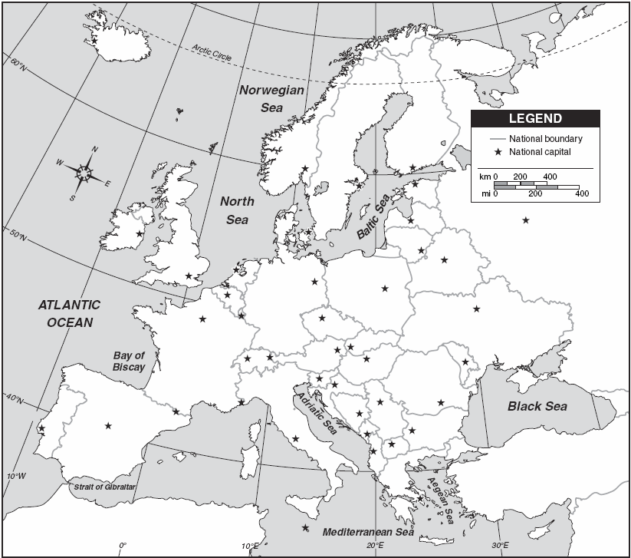
European
Countries
Study Guide
You will have
to identify
the 9
countries
shown on
this map.
You will be
given a
Word Bank
to help you.
United
Kingdom
RUSSIA
Belgium
GERMANY
POLAND
UKRAINE
FRANCE
ITALY
SPAIN

