Slide 1
Review Locations in Latin America

Slide 2
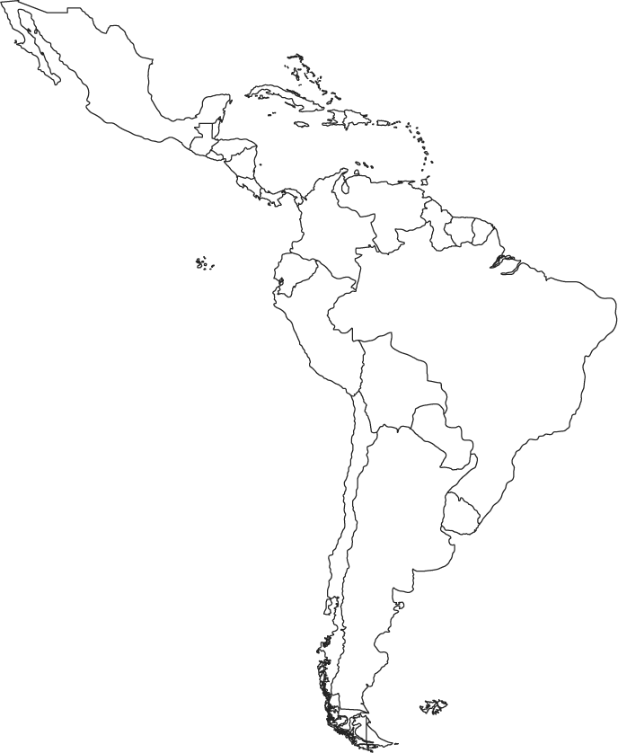
1. Political Map of Latin America
South America

Slide 3
2. Political Map of Latin America
Caribbean

Slide 4
3. Political Map of Latin America
Central America

Slide 5
4. Political Map of Latin America
Brazil

Slide 6
5. Political Map of Latin America
Colombia

Slide 7
6. Political Map of Latin America
Venezuela

Slide 8
7. Political Map of Latin America
Bolivia

Slide 9
8. Political Map of Latin America
Cuba

Slide 10
9. Political Map of Latin America
Haiti

Slide 11
10. Political Map of Latin America
Panama

Slide 12
11. Physical Map of Latin America
Mountains that run down the
Western coast of South America
Andes Mountains

Slide 13
12. Physical Map of Latin America
Mountains that border the east and west coast of Mexico
Sierra Madre
Mountains

Slide 14
13. Physical Map of Latin America
Dry desert that runs along the southern border of South America
Atacama
Desert

Slide 15
14. Physical Map of Latin America
Body of water that is surrounded by Mexico to its west, the US to its north, and the Caribbean islands to its south
Gulf of Mexico

Slide 16
15. Physical Map of Latin America
Body of water that is surrounded by the Caribbean islands to its north, South America to its south and Central America to its west.
Caribbean Sea

