Slide 1













Autocracy, Oligarchy, & Democracy

Slide 2



What is Citizen Participation?
In each country, the people have different rights to
participate in the government.
•In some countries, any citizen can run for office or vote in elections.
•In other countries, there are restrictions placed on who can run for office and who can vote.
•There are also countries where NO citizen can vote and there are no elections.

Slide 3


Three Types of Government
Types of Government are based on two key questions:
Who governs the country?
What is the citizen participation like?
The way a country answers these questions determines its government type:
Autocracy
Oligarchy
Democracy

Slide 4



Autocratic Governments:
Have a single ruler with unlimited power.
Citizens cannot participate in the selection of the ruler
or vote on the country’s laws.
One benefit – decisions for the country can be made quickly.
  However…the needs of the citizens may be ignored.
  The leader may make poor or selfish decisions that hurt the citizens.

Slide 5



Autocracy
Generally the power to rule the country is inherited
(kings/queens) or is taken by military force.
There are two main types of autocracies:
Dictatorship
The leader uses force to control the citizens.
Example? Hitler
Absolute Monarchy
The monarch has absolute power (no constitution) over the citizens.

Slide 6



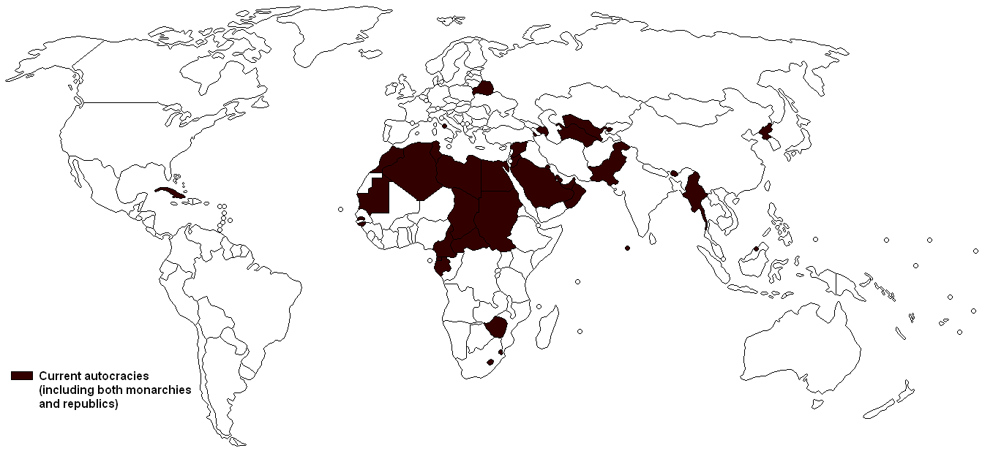
Autocracies of the World:

Slide 7



Oligarchic Governments:
The country is ruled by a small group of people.
•The group gets their power from either
religion, military force, or wealth & resources.
The citizens do not select the members of this
group or vote on the country’s laws.

Slide 8


Democratic Governments:
The citizens hold the power of the government.
Citizens have the opportunity to participate in the government:
•All citizens have the opportunity to be a
leader.
•All citizens have the opportunity to vote for
leaders & laws.

Slide 9



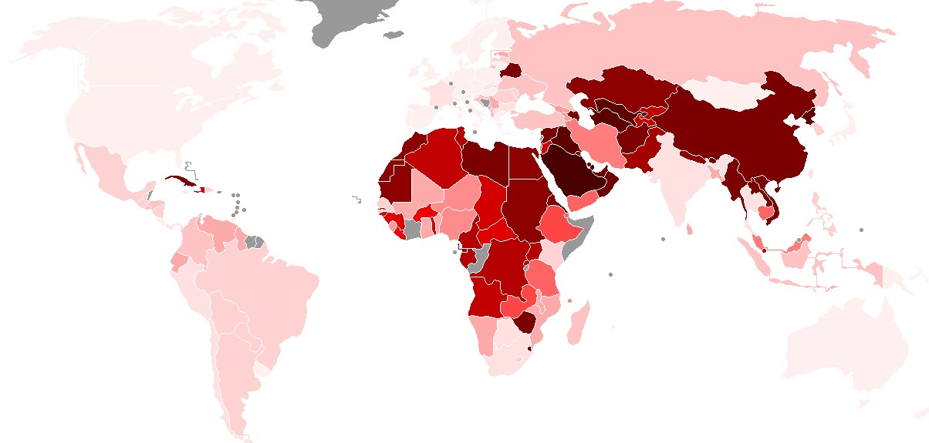
This Polity Data Series Map tries to measure a country’s true democracy in government. The countries in the lightest pink have the highest democracy score. The darker the color, the lower the score.

Slide 10
Democratic Governments:
There are two forms of democratic
governments:
Presidential Parliamentary
Both are designed to represent and protect the rights of the citizens.

Slide 11


Presidential Democracy
The citizens vote directly for the leader of the country.
Citizens also vote for members of the legislature, but separately from the leader.
•The leader of the country does not make the laws.
The legislature does this.
•Example: US, Russia, Mexico

Slide 12


Parliamentary Democracy
The citizens vote for members of the legislature, not directly for the leader.
The legislature then chooses the country’s leader among its members.
•The leader is part of the legislature, so he/she has a hand in making laws.
Examples: United Kingdom, Canada, & Australia

Slide 13

Who Am I?

Slide 14

Who Am I?

Slide 15

Who Am I?

Slide 16
Who Am I?

Slide 17



Who Am I?

Slide 18

Who Am I?

Slide 19


Let’s Review
What are the two types of Autocratic governments?
Who rules the country in an Oligarchy?
Compare and contrast Autocracy vs. Democracy.
What are the two types of Democratic governments?
How is the leader chosen in a Parliamentary democracy?
Do the citizens get to choose the leader in a
Parliamentary democracy?
How is the leader chosen in a Presidential democracy?

