Slide 1
Warm Up
OBJECTIVE: Students will understand use rates and unit rates to solve real-world problems.
Language Objective: Students will define rate and unit rate using real-world examples.
Alex is trying to win a jumping jack competition. He does
100 jumping jacks in 2 minutes.
Write a ratio in three ways comparing jumping jacks to minutes.
Remember to simplify!
1) _______ jumps to _________ minute
2) ________ jumps: __________ minute
3) Jumps 4) Write a sentence using ratio language.
minute
1) __50___ jumps to ____1____ minute
2) ___50___ jumps: ___1______ minute
3) 50 jumps 4) Write a sentence using ratio language.
1 minute Alex jumps 50 times for each second.
Agenda
Notes:
(3-5 min) Time passed
In-Class Notes
Students will review how to write ratios in 3 ways. Teachers should project the second slide only as a hint if students need help remembering how to write ratios in 3 ways.
The purpose of this warm-up is to remind students how to write ratios, remind students to label each part of a ratio, and also to simplify each ratio.
Preparation Notes

Slide 2
Agenda:
OBJECTIVE: Students will use rates and unit rates to solve real-world problems. Language Objective: Students will define rate and unit rate using real-world examples.
1) Warm Up (Individual)
2) Launch: Tillman the Skateboarder (Whole Class)
3) Explore: Mini-Lesson (Partner and Whole Class)
4) Summary (Whole Class)
5) Practice: (Partner and Whole Class)
6) Assessment: (Independent and Whole Class)
Notes:
(Time on this slide - min) Time passed
In-Class Notes
Preparation Notes

Slide 3
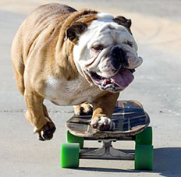
Launch
Watch the following video about Tillman, the world-recorder
holder for fastest skateboarder in his class.
Tillman Video
Why is Tillman special?
How do we know he’s the fastest
skateboarding dog?
In 2009, Tillman received the Guinness Book of
Records Award for fastest skateboarding dog,
when he rode 100 meters in 20 seconds.
Agenda
Notes:
(5 min) Time passed
In-Class Notes
Teachers should plan on starting the video clip at the 2 minutes mark and finish. The entire video is too much for the motivation and launch, and the music gets a little annoying.
Teachers should use then use calling sticks to ask students the follow-up questions. For the second question, how do we know he’s the fastest, we hope to encourage students to say their must have been a race or contest that involved a distance and timed event.
Then we can show his time.
Here is link to video: http://www.animalplanet.com/tv-shows/animal-planet-presents/videos/most-outrageous-skateboarding-bulldog/
Preparation Notes

Slide 4
Launch
In 2009, Tillman received the Guinness Book of
Records Award for fastest skateboarding dog,
when he rode 100 meters in 20 seconds.
(ex 1) Write Tillman’s record time as a ratio in fraction form.
*Remember to simplify and use lables!!!
This special ratio is a rate! Woof!
This example is special because we have 2 different units being compared, meters and seconds.
Agenda
Notes:
(3 min) Time passed
In-Class Note:
Teachers will use this ratio as a way to introduce the idea of rate. We will focus on the definition of rate in the next slide but it is important for teachers to make a big deal about a rate being a special kind of ratio because we are looking at 2 different units of measure.
Before moving to next slide, teachers should pause to ask students if they can write these ratios in a different way, i.e. using the colon or word to
Preparation Notes
Scaffolded Class notes

Slide 5
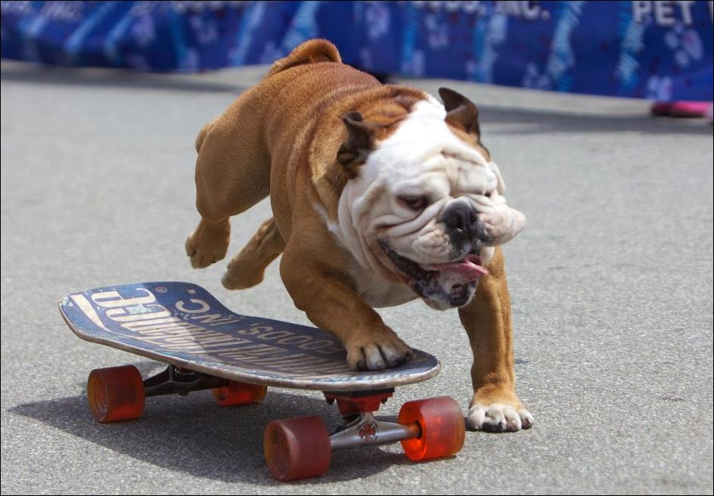
Explore – Mini Lesson
A rate is a ratio that compares 2 different measurements!
(ex) Tillman’s skateboarding rate is .
What happens when we simplify this rate?
This means that Tillman travels at a rate
of 5 meters for every 1 second.
I’m fast!
Agenda
Notes:
(2-3 min) Time passed
In-Class Notes
Teachers should ask students to fill in definition of rate on their class notes.
We will focus on the language and wording of rates in the next lesson but this slide will help introduce students to this concept.
Preparation Notes
Students will use their scaffolded class notes to fill in and follow along with lesson

Slide 6
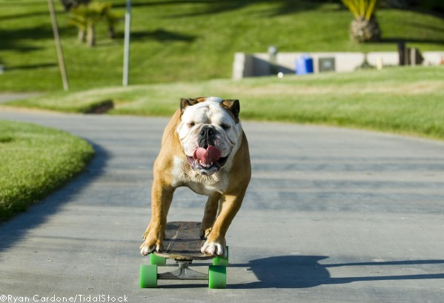
Explore
The word unit means 1.
Tillman’s rate of skateboarding:
A rate with a denominator of 1 has a special name!
UNIT RATE
A unit rate is a comparison of 2 different quantities where one measurement only has 1 unit.
Like Tillman’s speed, 5 meters to 1 second!
Agenda
Notes:
(3 min) Time passed
In-Class Notes
This slide will introduce students to the idea of unit rate. Students should copy down the definition in their class notes.
Preparation Notes
Class notes

Slide 7
Explore – Mini Lesson
A rate and unit rate are often found in the following real-world situations:
Distance and Time
(ex 1) Homer ran 60 yards in 20 seconds.
Cooking and Mixtures
(ex 2) A brownie recipe has 4 cups of flour for every 2 cups of sugar.of sug
ar.
What are the measurement we are comparing in (ex 1)?
Yes! Yards and seconds!
All rates and unit rates have 2 different measurements
Prices
(ex 3) Casey spent $80 on 8 pizzas.
Agenda
Notes:
(2-3 min) Time passed
In-Class Notes
Teachers may want to ask students to answer questions like, why are these real-world examples? How do we use distance and time everyday?
The call-out bubbles are to help reinforce students understanding of the definition of rate and unit rate.
Preparation Notes
Students will use their scaffolded class notes to fill in and follow along with lesson

Slide 8
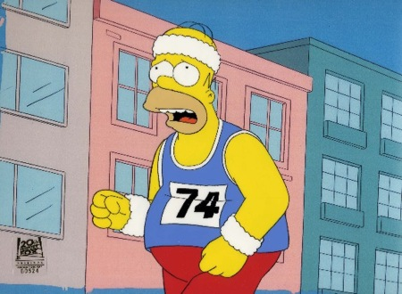
Explore – Mini Lesson
A unit rate can be found using the following steps.
(ex 1) Write Homer’s speed as a unit rate.
Homer ran 60 yards in 30 seconds.
Step 1: Write as a rate in fraction form.
How did we know this is a rate question?
D’oh! I get it, we have yards and seconds, 2 different measurements.
For every is getting old! Let’s try a new word in our sentence!
PER!
The word “per” can be used for unit rates only, like this!
60 yards
30 seconds
Step 2: Simplify the rate so the denominator is 1.
2 yards
1 seconds
This unit rate means that, Homer ran 2 yards for every 1 second.
Homer ran 2 yards per second.
Agenda
Notes:
(2-3 min) Time passed
In-Class Notes
Teachers can ask students what Homer is doing in his photo – how does this connect with the real world?
The real goal of this slide is to help students reinforce simplifying rates down to unit rates using simple numbers. In the next PP, we will tackle simplifying with more complex #s.
Teachers can introduce per in this slide, and remind students that it is just like “for each” when we use per, it replaces the 1.
Preparation Notes
Students will use their scaffolded class notes to fill in and follow along with lesson

Slide 9
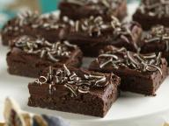
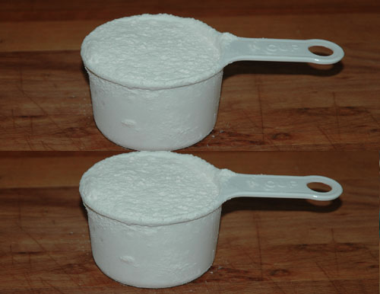
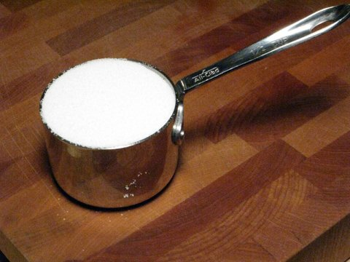
Explore – Partner Work
(ex 2) A brownie recipe has 4 cups of flour for every 2 cups of sugar.
Step 1: Write as a rate in fraction form.
4 cups of flour
2 cups of sugar
Wait! Is this still a rate? We are comparing cups of flours to cups of sugar, does that count?
Step 2: Simplify the rate so the denominator is 1.
Yes, we have 2 different measurements cups of flour and cups of sugar!
2 cups of flour
1 cup of sugar
This unit rate means that there are 2 cups of flour per cup of sugar.
Agenda
Notes:
(6 min) Time passed
In-Class Notes
Teachers can begin this slide by asking students why this is a real world example.
Students can then try this with a partner on their scaffolded notes and then the teacher can review the question or go over any questions with students.
Teachers should emphasis that a unit rate again tells us that we have a 1 for the denominator in our ratio fraction.
Preparation Notes
Students will use their scaffolded class notes to fill in and follow along with lesson

Slide 10
Challenge – Partner Work
(ex 3) Ricardo wants to buy 40 key chains for his new business. An online merchant has the following special posted.
SPECIAL:
80 Key Chains for $40
Ricardo completes the following calculations to find the unit price:
80 key chains
$40
2 key chain
$1
=
=
2 key chains per $1
Is Ricardo right? Why or why not?
Agenda
Notes:
(4 min) Time passed
In-Class Notes
Teachers should ask students to try to work through this problem first in their partners and then work as a whole class.
The goal of this slide is to help students understand that units must go with their correct labels and also that we must find the UNIT for the object or key chain not the dollar amount.
This topic will be explored more in-depth in this lesson but hopefully we will introduce idea in this last higher-order question.
Preparation Notes
Students will use their scaffolded class notes to fill in and follow along with lesson

Slide 11
Challenge – Partner Work
(ex 3) Ricardo wants to buy 40 key chains for his new business. An online merchant has the following special posted.
SPECIAL:
80 Key Chains for $40
Ricardo completes the following calculations to find the unit price:
80 key chains
$40
2 key chain
$1
=
$2 per key chain
____$40_____
80 key chains
____$1___
2 key chains
=
=
$0.50 per key chain
Agenda
Notes:
(2 min) Time passed
In-Class Notes
Teachers can ask students how they found the answer, and then go through this slide to show students the correct work.
Preparation Notes
Students will use their scaffolded class notes to fill in and follow along with lesson

Slide 12
Summary
_units_.
A rate is a ratio that compares 2 different ______.
A unit rate represented as a fraction has a ____________ of 1.
How are rates and unit rates similar?
How are rates and unit rates different?
One real world example of rates and unit rates is ________________________ .
denominator
Both are ratios that have 2 different units.
Rates can be any #s with different units compared but unit rates must have 1 in denominator.
Agenda
Notes:
(5-7 min) Time passed
In-Class Notes
Teachers should call on students using calling sticks to illict answers from students.
Please note that teachers should fill in answer for #3 based on student suggestions.
Preparation Notes

Slide 13
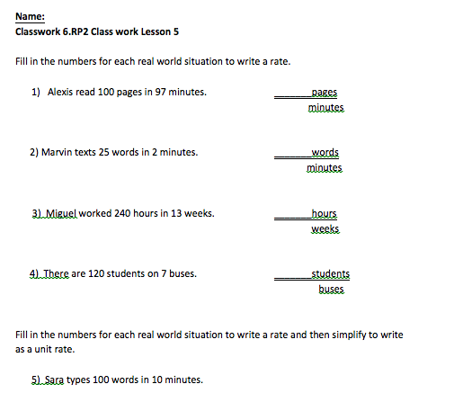
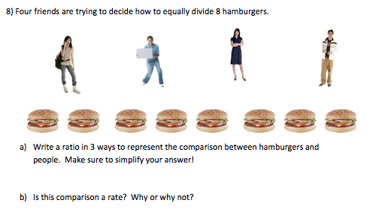
Practice
Agenda
Notes:
(10 min) Time passed
In-Class Notes
Students should work on the following class work assignment for 10 minutes or less (depending on how much time you have left in class.
Preparation Notes
Copies of class notes for teachers.

Slide 14
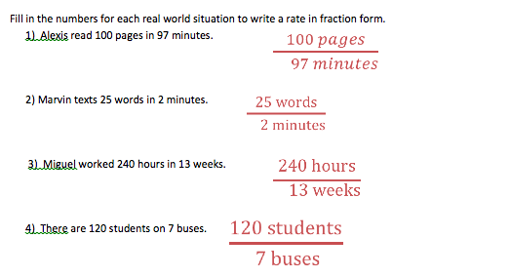
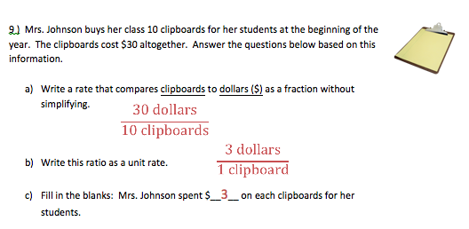
Practice
Agenda
Notes:
(5 min) Time passed
In-Class Notes
Teachers can review answers with students.
It is suggested that teachers let students check their answers, and then review 1-2 questions as a whole class to ensure that students have reviewed.
Preparation Notes

Slide 15
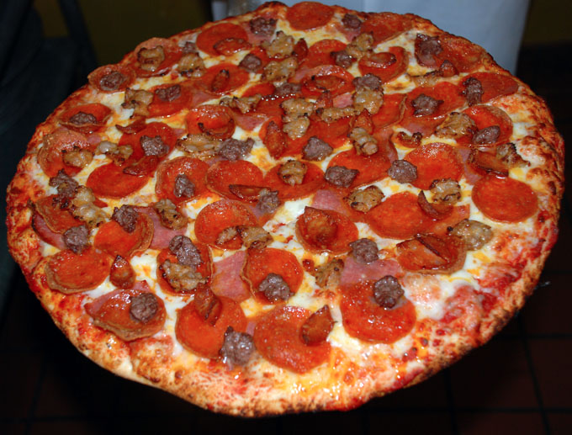
Assessment
Casey spent $80 on 8 pizzas.
Write a rate as a fraction to represent this situation.
Write a unit rate as a fraction to represent this situation.
_$80_
8 pizzas
_$10_
1 pizza
Agenda
Notes:
(3-5 min) Time passed
In-Class Notes
Students can complete this assignment on a post-it note or independently.
Students should write their names and answers on the post-it or index card, and teachers can collect.
Before students leave class, teachers can quickly review answers.
Preparation Notes
Index cards, post-it notes or half-sheet of paper

